Slide 1
Dramatic (Poetic) Terminology
Sonnet: a poem of 14 lines with a formal rhyme scheme, typically with 10 syllables per line.
Shakespearean sonnet is made of 3 quatrains of 4 lines each, resolved by a couplet.
Couplet: two lines of verse, usually in the same meter and joined by rhyme, that form a unit.

Slide 2
Dramatic (Poetic) Terminology
Is Romeo’s monologue (1.5.51-60) a sonnet? Why or why not?
Have you ever read a Shakespearean Sonnet?

Slide 3
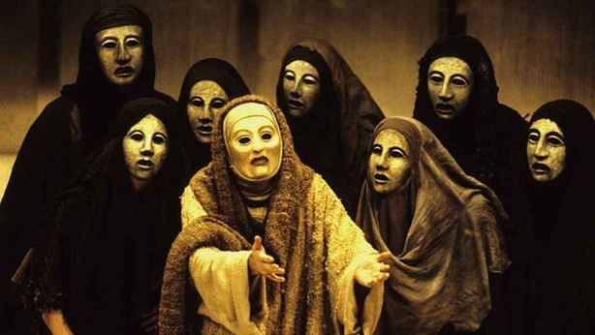
Dramatic Terminology
Chorus:
A character (or group of characters) that speaks the prologue and comments on the course of the events.
A chorus was a significant piece of Greek drama, arising from songs sung at various seasons to Dionysus; Athenian dramas used choruses to advise and restrain chief characters.

Slide 4
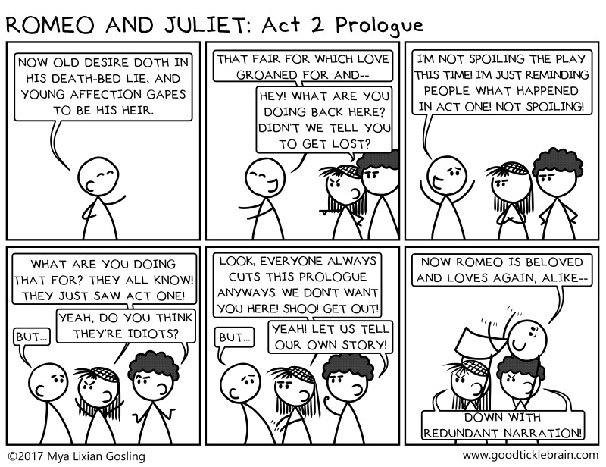
Dramatic Terminology
Chorus:
Shakespeare uses the chorus to…?
Assist in scene changes
Review the events
Provide an outside perspective

