Slide 1
Blackout Poetry
Assignment: Create a Blackout Poem using text from Haroun.
Display the poem on some kind of backing paper (any size; no lined paper)
Provide a 1-2 paragraph justification/ explanation on Turnitin.com
MLA Format

Slide 2
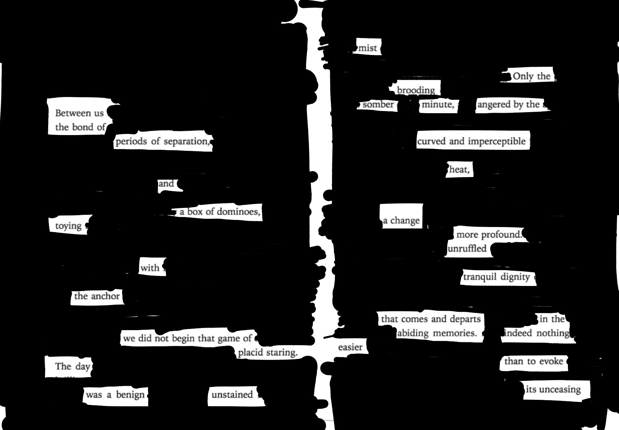
Blackout Poetry
A form of “found poetry”/ “found art”
AKA “Erasure poetry”

