Slide 1
Satire Unit
Learning Objectives:
Analyze examples of satire
to determine which satirical techniques are used and why
to determine author’s purpose
Evaluate satire for effectiveness.

Slide 2
Satire two definitions
satire: A literary convention which blends humor with criticism for the purpose of instruction or the improvement of humanity
satire: Use of wit, especially irony, sarcasm, and ridicule, to criticize faults

Slide 3
Satire ingredients
Humor
Criticism, either general criticism of humanity or human nature or specific criticism of an individual or group
Some kind of moral voice: simply mocking or criticism is not “satire.”

Slide 4
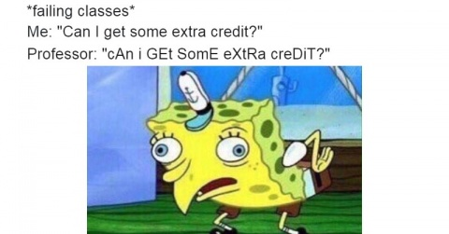
Satire mockery =/= satire

Slide 5
Satire examples?
With your group, brainstorm examples of satire.
Political cartoons; Saturday Night Live sketches; Last Week Tonight with John Oliver; stand up comedy; the Daily Show; the Colbert Report; Animal Farm

Slide 6
Satire historical connection
Used in ancient Egypt, Greece, Rome
Used in medieval Arabic poetry
Age of Enlightenment
Brought revival of satire
Fueled by rise of partisan politics
Propagated by new printing techniques

Slide 7
Text: Jonathan Swift’s A Modest Proposal (1729)
Full name: A Modest Proposal for Preventing the Children of Poor People from Being a Burden to Their Parents or Country, and For Making them Beneficial to the Publick

Slide 8
Text: Jonathan Swift’s A Modest Proposal
Read and annotate

Slide 9
Satirical Tone
Ironic/Sarcastic
Always opposed to pretense and hypocrisy
More than a little bit prone to references to things society finds taboo or disgusting (bodily functions, sexuality, etc.)

Slide 10
Satirical Media
Writing
Fiction
Essays
Faux (fake) news
Film
Visual Art
Political Cartoons
Caricatures
Quick note— “Media” is the plural form of “medium” (although you can also say “mediums”)

Slide 11
Satire:
Exaggeration: To enlarge, increase, or represent something beyond normal bounds so that it becomes ridiculous and its faults can be seen.

Slide 12
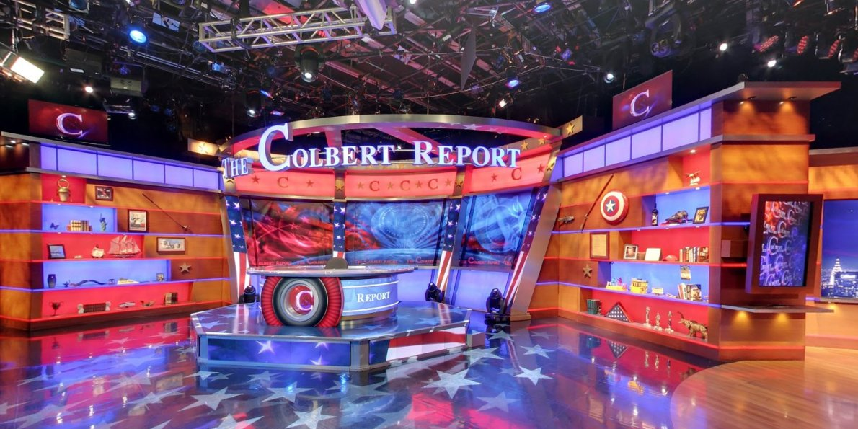
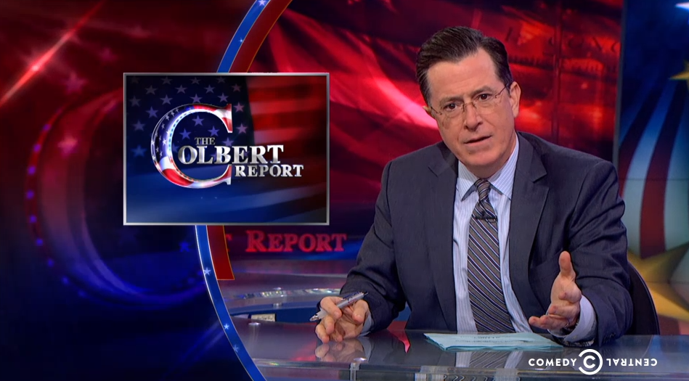
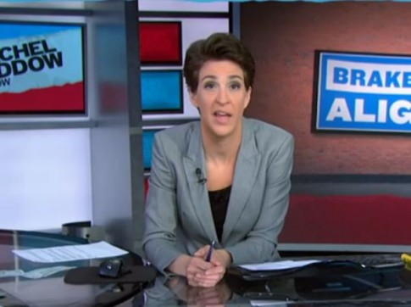
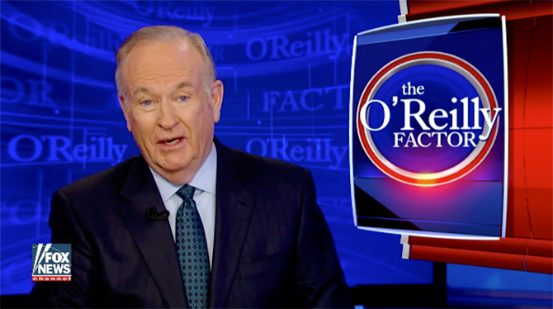
Satire:
Exaggeration: To enlarge, increase, or represent something beyond normal bounds so that it becomes ridiculous and its faults can be seen.

Slide 13
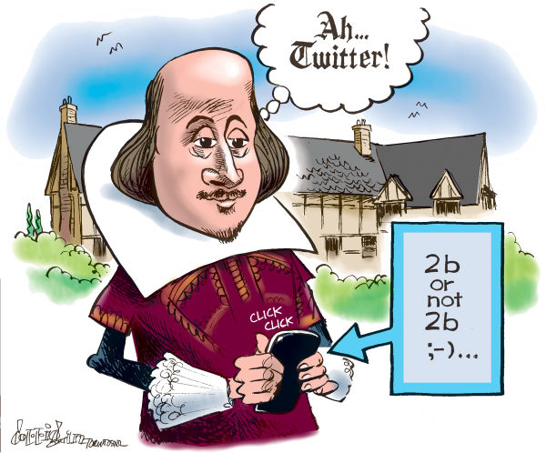
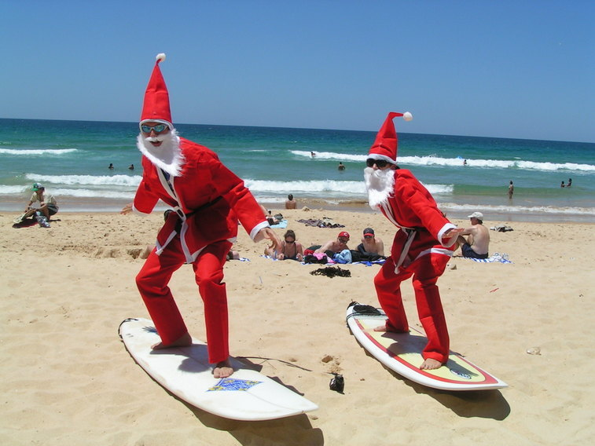
Satire:
Incongruity: To present things that are out of place or are absurd in relation to its surroundings.

Slide 14
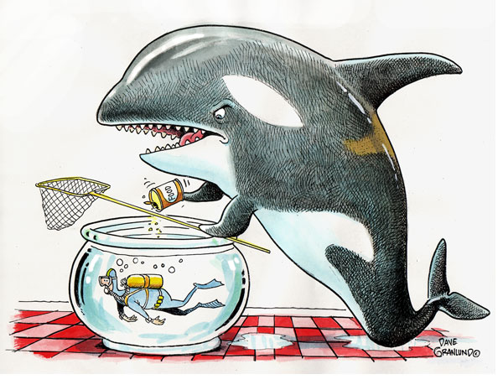
Satire:
Reversal: To present the opposite of the normal order (e.g., the order of events, hierarchical order).

Slide 15
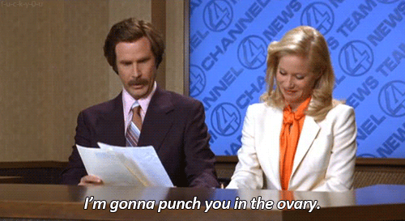
Satire:
Parody: To imitate the techniques and/or style of some person, place, or thing.

