Slide 1
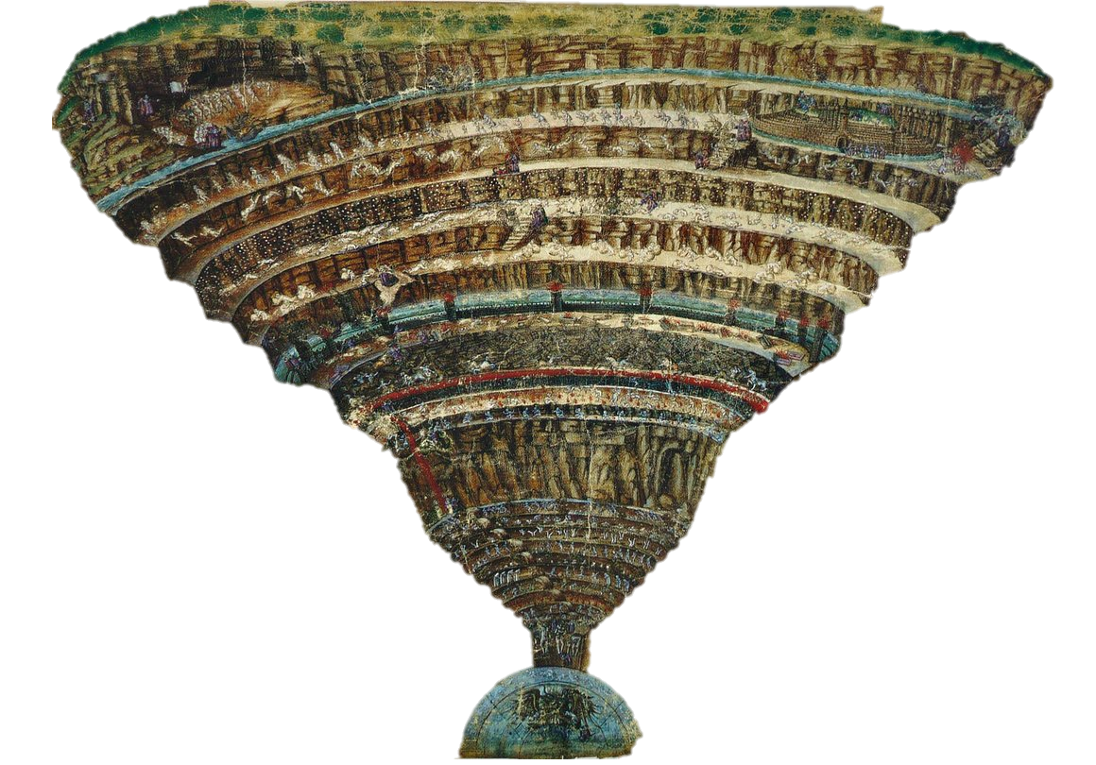
Circles of Hell

Slide 3
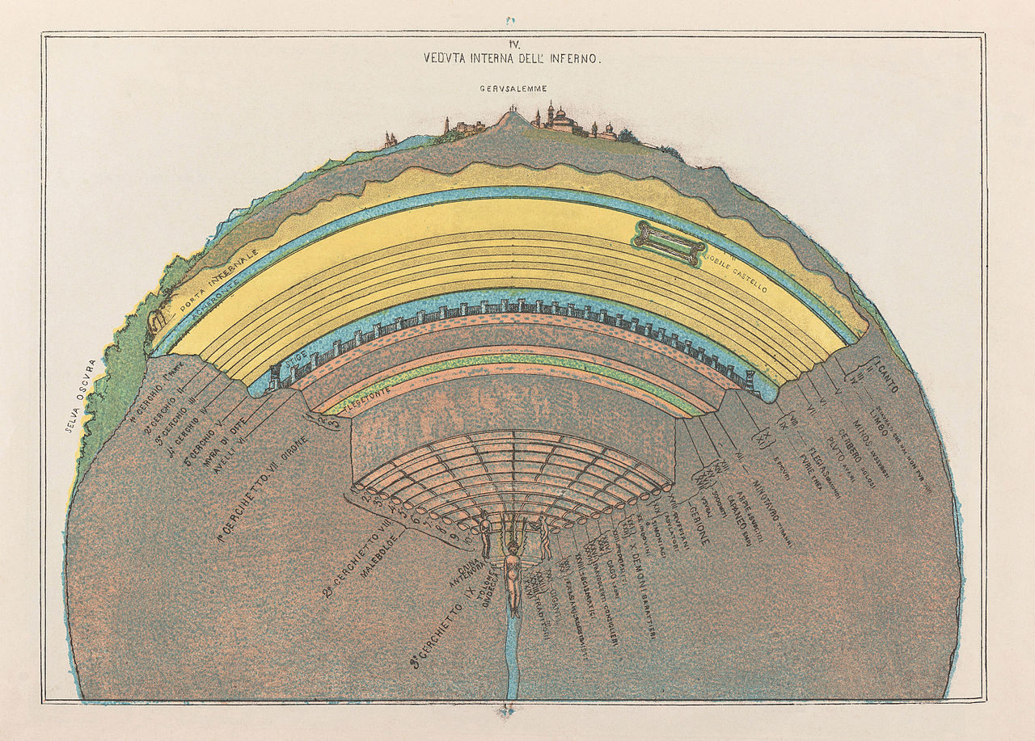

Slide 4
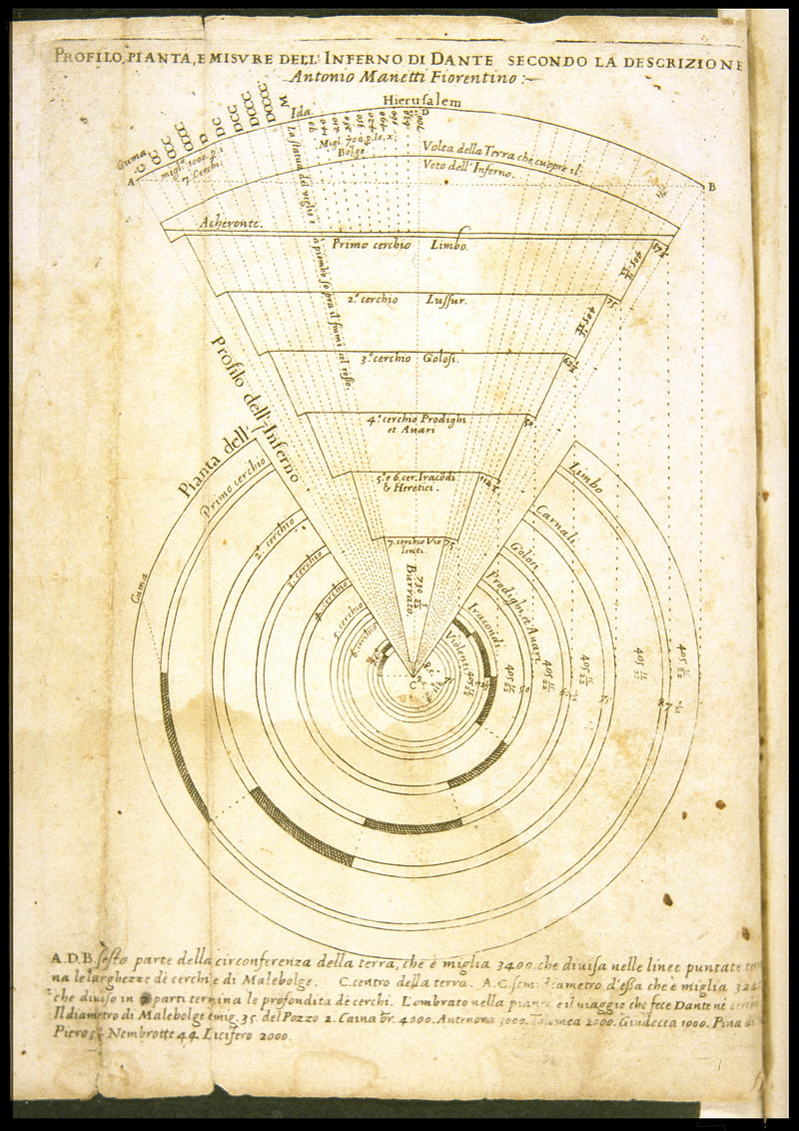

Slide 5
Structure of hell
According to Dante, what is the structure of hell?
Why is it conical?

Slide 6
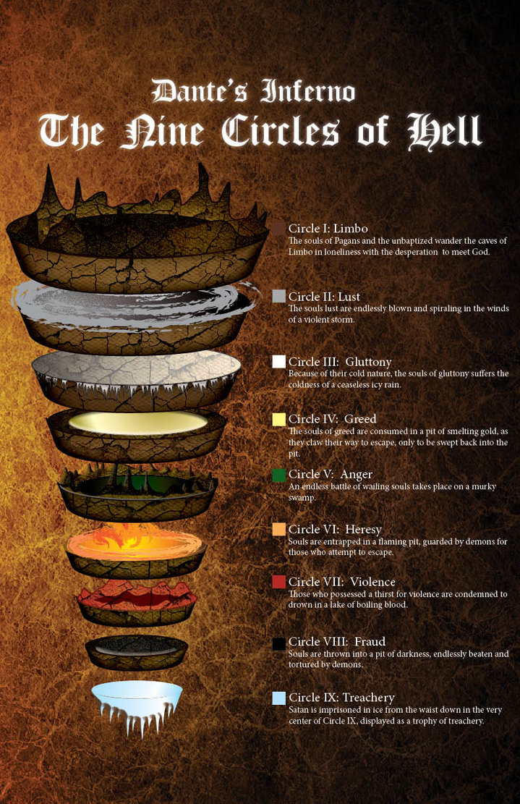
9 circles of Hell
MAIN CHARACTERS - Dante & Virgil
The designation of different kinds of sins beginning with sins of weakness, moving down to sins of malice, followed by sins of fraud and disloyalty, and finally descending to sins of betrayal and pride

Slide 7
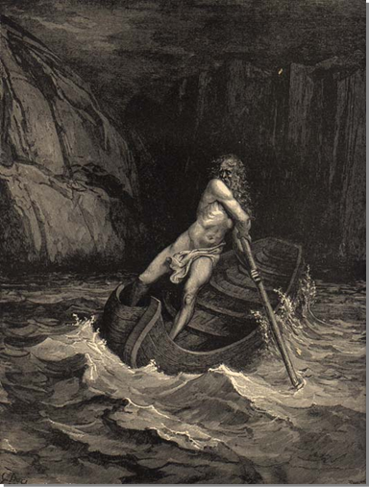
The Vestibule
The Gateway to Hell
The indecisive; no real beliefs, those who don’t choose sides
Not good or evil
Charon guides souls across the river Styx
Souls forced to move constantly while being stung and bitten by wasps and flies for eternity

Slide 8
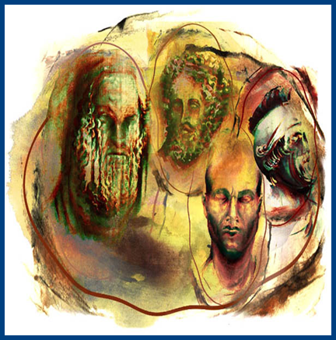
The First Circle
Limbo: Stuck between heaven and hell
Who is here: Virtuous pagans and unbaptized infants
Famous People stuck here: Homer, Socrates, Plato, Saladin, Avicenna (Ibn Sina)

Slide 9
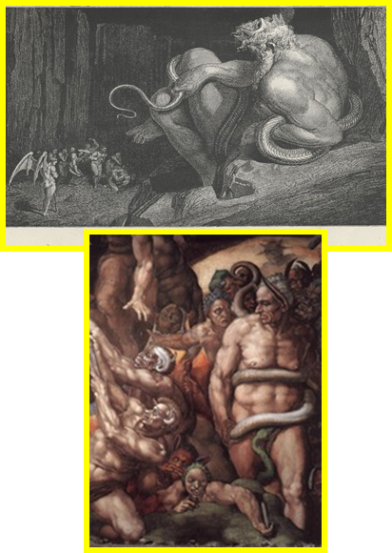
The Second Circle
Lust
Minos sits in judgment
Who is here: "carnal sinners who subordinate reason to desire"
Famous Faces: Cleopatra, Helen/ Paris, Achilles, Tristan
Punishment: Blown about forever by stormy winds just as, in life, they were blown about by the winds of passion – a sin of weakness

Slide 10
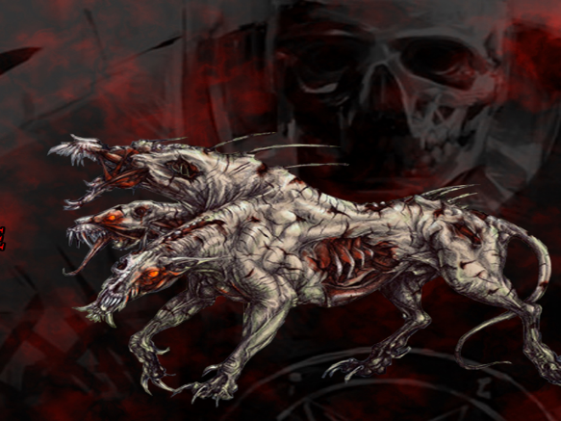
The Third Circle
Gluttony
Guarded by Cerberus
Punishment: Wallow in mud and muck besieged by hail and filthy water.

Slide 11
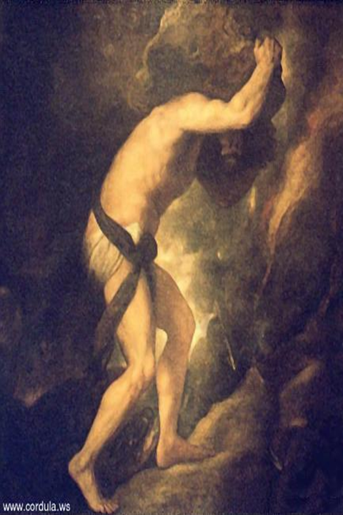
The Fourth Circle
Greed and Waste
Two groups
Each pushing a boulder against each other
Symbolic of their mundane existence on earth, with sin punishing in opposite sin

Slide 12
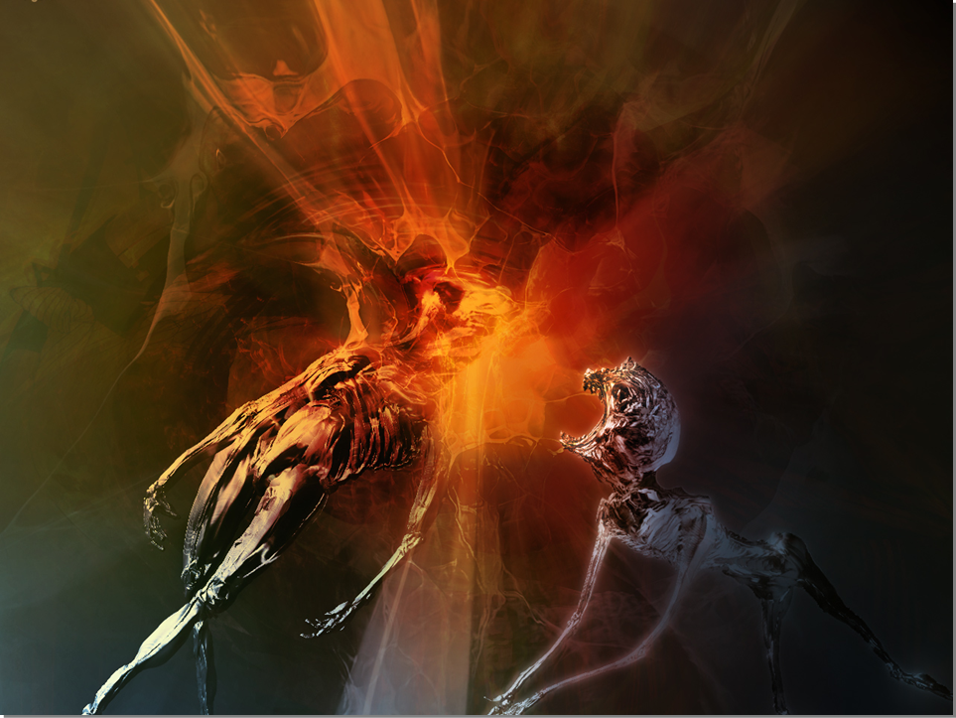
The Fifth Circle
Wrath and Sloth
Punishment: trapped beneath the swampy water in the River Styx
attacking one another forever, or just skulking around

Slide 13
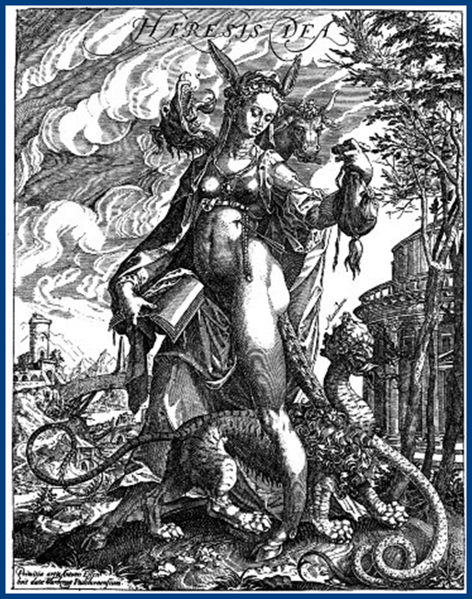
The Sixth Circle
Heresy
People there: Atheists & Non believers in the afterlife
Punishment: Entombed in flaming graves for all eternity
They believe the soul dies with the body, so that is their fate

Slide 14
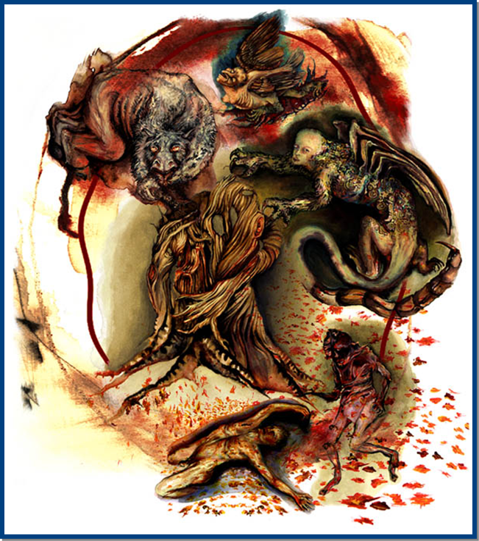
The Seventh Circle
Violence
Against God, his creation (other people), and self.
Violent against Neighbors: on the boiling bloody River Phlegethon;
Violent against Self: in the Wood of Suicides
Violent against God, Art, and Nature: on the Burning Sand.
Centaurs keep the violent from escaping

Slide 15
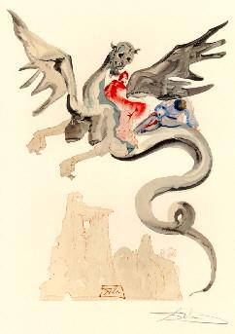
The Eighth Circle (the “malebolge” – evil ditches)
Fraud
Pimps, panderers, fortune-tellers, flatterers, hypocrites, thieves, evil counselors, deceivers, the scandalous, falsifiers
Many different punishments for each – 10 bolgias (ditches) – on next slides
Dante and Virgil ride in on Geryon, personification of fraud - Cheerful face of a human, but has a scorpion tail
“On Geryon’s Back” – Salvador Dali

Slide 16
Frauds + Punishments The ten bolgia (ditches)
1 | Seducers | Run forever in opposite directions and are whipped by demons
2 | Flatterers | Lie up to their necks in human feces – like the “bull” they spoke while alive
3 | Simoniacs | (Those who buy pardons or benefices) Placed head-first in flaming holes
4 | Sorcerers, false prophets, astrologers | Their heads are twisted around on their bodies backward
5 | Grafters | (Corrupt politicians who abuse their power) Trapped in a lake of burning tar

Slide 17
Frauds + Punishments The ten bolgia (ditches)
6 | Hypocrites | Made to wear brightly painted lead cloaks – “just as Jesus compares hypocritical scribes and Pharisees to tombs that appear clean and beautiful on the outside while containing bones of the dead (Matthew 23:27), so the bright golden cloaks of Dante's hypocrites conceal heavy lead on the inside (Inf. 23.64-6)”
7 | Thieves | Chased by venomous snakes and who, after being bitten by the venomous snakes, turn into snakes themselves and chase the other thieves in turn -No possession, not even your own body, is safe from theft
8 | Evil Counselors/ Deceivers | Eternally trapped in flames – Speaking “tongues of flame”
9 | Sowers of discord | Their bodies are sliced apart, healed, and then destroyed again Bertran de Born, who carries around his severed head like a lantern – He caused a schism by inciting Henry the Young King against his dad Henry II
10 | Falsifiers | (Alchemists, counterfeiters, and perjurers)Cursed with disease – mirrors their “corrupting influence”

Slide 18
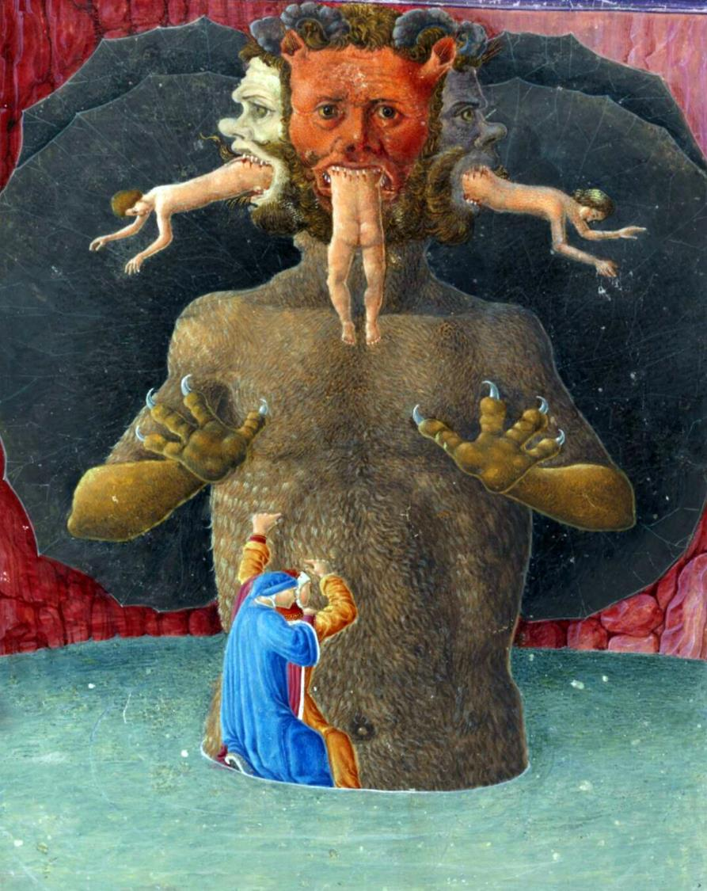
The Ninth Circle
Betrayal
Those who betrayed their benefactors
Most are frozen up their necks in ice, crying out for those they betrayed for eternity
Home of Lucifer/Satan/Dis/Beelzebub who has 3 faces; huge size, zero power
Devours the worst of the three betrayers daily in each mouth
Judas: Betrayer of Jesus Christ
Brutus & Cassius: Betrayers of Julius Caesar

Slide 19
Contrapasso
Contrapasso is the concept that for every sin there is an equal and matching punishment
Etymology: contra- (counter), -passo (step)
It "functions not merely as a form of divine revenge, but rather as the fulfilment of a destiny freely chosen by each soul during his or her life.“
Supports the idea that God is just – Hell is not a random punishment but the end destination of a person’s bad path through life

Slide 20
Contrapasso
Is Contrapasso the same as “an eye for an eye”?
“Fracture for fracture, eye for eye, tooth for tooth, the same sort of injury he inflicted should be inflicted on him.”​—Leviticus 24:20 (Old Testament of the Bible)
Yes and no
Yes because Contrapasso implies that a sin requires an equal punishment
No because “an eye for an eye” focuses on the damage done, not on the sin itself. Dante believed a sin should be punished regardless of the damage done, because it is offensive to God (rather than just harmful to another human)

Slide 21
Literary Terminology
Allegory a story, poem, or picture that can be interpreted to reveal a hidden meaning, typically a moral or political one.

