Slide 1
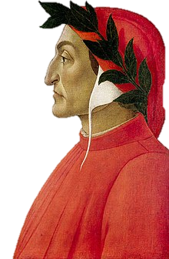
Dante Alighieri
the world’s greatest poet of ideas

Slide 2
Dante Alighieri
Born 1265, died 1321
Late Middle Ages
Widely regarded as “the world’s greatest poet of ideas”

Slide 3
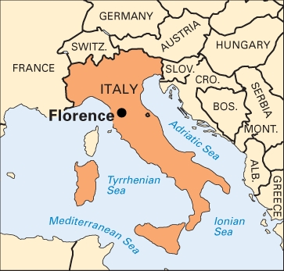
Dante Alighieri
From Florence (Firenze) Italy
From a wealthy family
Studied poetry and literature
Writer and politician
Age 9: Sees and falls in love with a girl named Beatrice

Slide 4
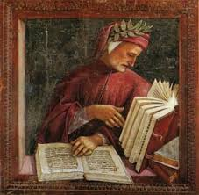
Dante Alighieri
Big political rivalry in Florence at the time:
the Guelphs vs the Ghibellines
Guelphs: supported the Papacy
Ghibellines: supported the Holy Roman Emperor
Dante was a Guelph, as was his father.

Slide 5
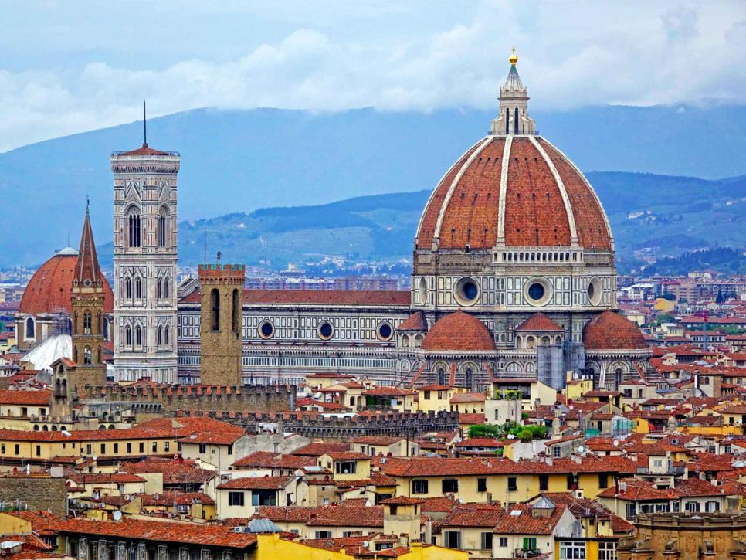
Dante Alighieri
Later, the Guelphs split into the White Guelphs and the Black Guelphs
White Guelphs: pro-Papacy (Dante)
Black Guelphs: Wanted more freedom
Florence, Italy

Slide 6
Black vs white
“It all started in Pistoia, a few miles from Florence. Two branches of the Cancellieri family quarreled over an insignificant incident. It seems that one nephew was chastised by an uncle for throwing a snowball. A few days later, in revenge, the nephew struck the uncle. It would have all stopped there, for the uncle thought nothing of it. However his son, Focaccia caught his cousin and cut off his hands. Then as if this were not enough, went after the father, his uncle, and killed him. A feud developed among the ruling Guelphs over the murder which resulted in the splitting into two parties: Neri (Blacks) and Bianchi (Whites). The Bianchi got their name after Bianca Cancellieri, so the opposing faction chose the color Black as its standard. Civil war broke out.” – Dante Aligheri Society of Massachusetts

Slide 7
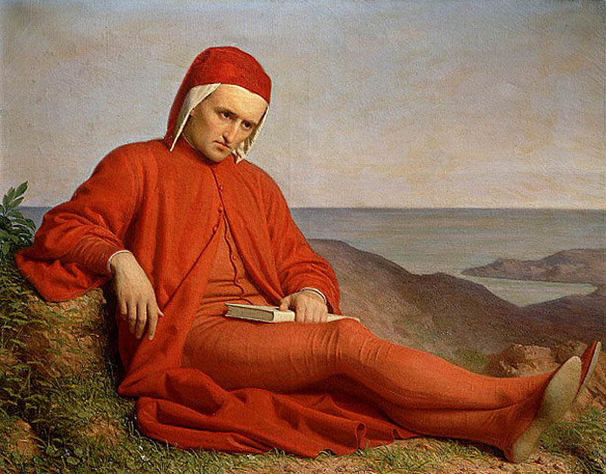
Dante Alighieri
The Black Guelphs took power in Florence and exiled Dante for two years and ordered him to pay a fine
He refused to show up for trial, and he was exiled for life.

Slide 8
Dante Alighieri
In exile, Dante wrote many great works
Most famous: The Divine Comedy (La Divina Comedia)

Slide 9
The Divine comedy
Dante himself described a Comedy as:
“all poetry in middle style with a terrifying beginning and a happy end, written in the vernacular.”
Inferno is the first section of the Divine Comedy.

Slide 10
About the Author and His Time
Where is Italy? Where is Florence? Where was Dante schooled?
Who were the Ghibillines and the Guelphs? What political party did Dante belong to?
What sparked the rivalry between the White and Black Guelphs?
Where was the author during the composition of his work and what was his occupation?

Slide 11
The structure of The Divine Comedy

Slide 12
Inferno - structure
The Divine Comedy is divided into three major parts:
Inferno (Hell)
Purgatorio (Purgatory)
Paradiso (Paradise/Heaven)
These parts are called cantiche (plural; singular: cantica; in English, “canticles”)

Slide 13
#TBT

Slide 14
Inferno - structure
Each of the three parts (cantiche) are divided into sections called canti (or “cantos”).
Each part has 33 cantos.
There is an extra introductory canto at the beginning, so…
Total number of cantos: 100.

Slide 15
Inferno - structure
The Divine Comedy uses a fixed meter and rhyme scheme throughout.
Meter: the pattern of stressed and unstressed syllables in a poem
Rhyme scheme: the pattern of rhymes in a poem
Read the first page, and annotate what you notice about the meter and rhyme scheme.

Slide 16
Inferno - structure
The Divine Comedy was written in Italian, so we read translations. ☺
Some translations focus on style (rhyme, meter, etc;) some prefer to focus on reflecting the meaning correctly

Slide 17
Inferno - structure
Nel mezzo del cammin di nostra vita mi ritrovai per una selva oscura, ché la diritta via era smarrita.
Ahi quanto a dir qual era è cosa dura esta selva selvaggia e aspra e forte che nel pensier rinova la paura!
Tant' è amara che poco è più morte; ma per trattar del ben ch'i' vi trovai, dirò de l'altre cose ch'i' v'ho scorte.
Io non so ben ridir com' i' v'intrai, tant' era pien di sonno a quel punto che la verace via abbandonai.

Slide 18
Inferno - structure
Nel mezzo del cammin di nostra vita mi ritrovai per una selva oscura, ché la diritta via era smarrita.
Ahi quanto a dir qual era è cosa dura esta selva selvaggia e aspra e forte che nel pensier rinova la paura!
Tant' è amara che poco è più morte; ma per trattar del ben ch'i' vi trovai, dirò de l'altre cose ch'i' v'ho scorte.
Io non so ben ridir com' i' v'intrai, tant' era pien di sonno a quel punto che la verace via abbandonai.

Slide 19
Inferno - structure
Nel mezzo del cammin di nostra vita A mi ritrovai per una selva oscura, B ché la diritta via era smarrita. A
Ahi quanto a dir qual era è cosa dura B esta selva selvaggia e aspra e forte C che nel pensier rinova la paura! B
Tant' è amara che poco è più morte; C ma per trattar del ben ch'i' vi trovai, D dirò de l'altre cose ch'i' v'ho scorte. C
Io non so ben ridir com' i' v'intrai. D tant' era pien di sonno a quel punto E che la verace via abbandonai. D

Slide 20
Inferno - structure
The Rhyme Scheme of the Divine Comedy is called terza rima.
“Interlocking” form – ABA, BCB, CBC, DCD…
Each stanza is called a tercet.
The only time the form changes is at the conclusion of the poem, where a single line that rhymes with the second line of the final tercet stands alone; the rhyme scene at the end of the poem looks like this: “xyx yzy z”.

Slide 21
Inferno - structure
Nel mezzo del cammin di nostra vita A mi ritrovai per una selva oscura, B ché la diritta via era smarrita. A
Ahi quanto a dir qual era è cosa dura B esta selva selvaggia e aspra e forte C che nel pensier rinova la paura! B
Tant' è amara che poco è più morte; C ma per trattar del ben ch'i' vi trovai, D dirò de l'altre cose ch'i' v'ho scorte. C
Io non so ben ridir com' i' v'intrai. D tant' era pien di sonno a quel punto E che la verace via abbandonai. D...
...
Or va, ch'un sol volere è d'ambedue: Y tu duca, tu segnore e tu maestro». Z Così li dissi; e poi che mosso fue, Y
intrai per lo cammino alto e silvestro. Z
<- Last tercet + one “bonus” line

