Slide 2
Literary Devices - Definitions
Literary Devices refers to the typical structures used by writers in their works to convey his or her messages in a simple manner to the readers.
Literary devices or literary techniques are specific structures that writers often use to add meaning or create more compelling stories for the reader.

Slide 3
Two Major Subcategories
Literary Elements
Literary Techniques
have an inherent existence in literary piece and are extensively employed by writers to develop a literary piece
structures (usually words or phrases) in literary texts that writers employ to achieve not merely artistic ends but also readers a greater understanding and appreciation of their literary works.
Tools

Slide 4
Two Major Subcategories
Literary Elements/Concepts
Literary Techniques
Plot
Setting
Theme
Mood
Bildungsroman
Tone
Exist inherently
Metaphor
Alliteration
Idiom
Personification
Anastrophe
Synecdoche
Tools

Slide 5
Literary DEVICE (Literary Element)
Vignette: a brief evocative description, scene, or episode
More about imagery than plot
Stands alone
“Snapshot of words”
Very brief
Trying to create a mood/feeling
Focuses on one element of a story

Slide 6
Figurative Language Devices in HOMS
Learning Targets:
Students will be able to define figurative language.
Students will be able to identify simile, metaphor, personification, idiom, and euphemism and explain their effect on the text.
Students will be able to give examples of simile, metaphor, personification, idiom, and euphemism.

Slide 7
Figurative Language
Literary Devices
Literary Techniques
Figurative Language
=Language that is not literal

Slide 8
Examples of Figurative Language
Metaphor - figurative language that compares two (usually unrelated) things
Simile - figurative language that compares two (usually unrelated) things using like or as
Personification - figurative language that gives human characteristics to inhuman things

Slide 9
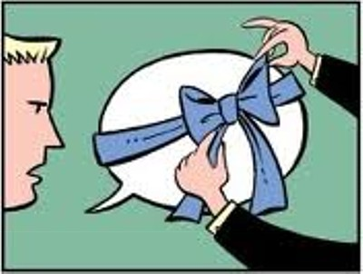
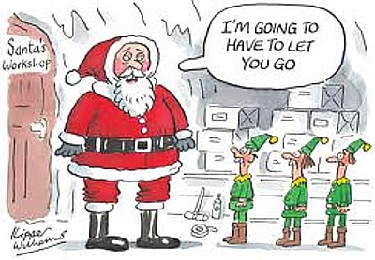
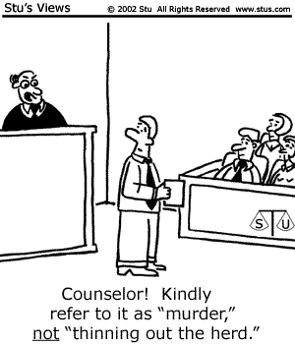
What does Euphemism mean?

Slide 10
What does Euphemism mean?
EXAMPLES:
Eric’s driving skills left plenty of room for improvement.
I got in a bit of trouble for stretching the truth about the broken lamp.
Ew! My dad wanted to have the birds and bees talk.
These TVs fell off the back of a truck.
Your grandma’s in a better place now.
He is just big boned.
Actually, I’m between jobs at the moment.
What are these people really saying?

Slide 11
Euphemism
Euphemism: Mild or indirect word or expression that is figuratively used to replace something that is embarrassing or rude to talk about.
Euphemisms often are used to replace topics like:
Death
Your grandma’s in a better place now.
Sex
Ew! My dad wanted to have the birds and bees talk.
Other uncomfortable subjects

Slide 13
Euphemism in HOMS
We just read “There was an Old Woman She Had So Many Children She Didn’t Know What to Do”
What was the Euphemism? What was the Euphemism for?
Why would “hit the ground like a sugar donut” or “exploding star” not make a good euphemisms? (30).
With a partner come up with your own euphemism
Why would an author use euphemisms? How would it help create an unreliable narrator?
What evidence do we have that “learned to fly” is the euphemism?

Slide 14
What do these have in common?
To break one’s pipe – casser sa pipe
To pull the leathers – tirare le cuoia
To kick the calendar - kopnąć w kalendarz
To kick the bucket
They all mean “to die.”

Slide 15
What do these have in common?
To break one’s pipe – casser sa pipe - French
To pull the leathers – tirare le cuoia - Italian
To kick the calendar - kopnąć w kalendarz - Polish
To kick the bucket
They all mean “to die.”
What type of figurative language are these?

Slide 16
Idioms - Examples
On the ball
Bite the bullet
Get something out of your system
It’s raining cats and dogs
Kick the bucket
Get to the bottom of the situation
Cold shoulder
Couch potato

Slide 17
Idiom - definition
Idiom: a short phrase established by usage as having a static figurative meaning
Idiom: a short phrase established by usage as having a fixed figurative meaning
Because idioms are figurative, you cannot translate them literally.
Most languages have their own idioms. Can you think of any in another language?

Slide 18
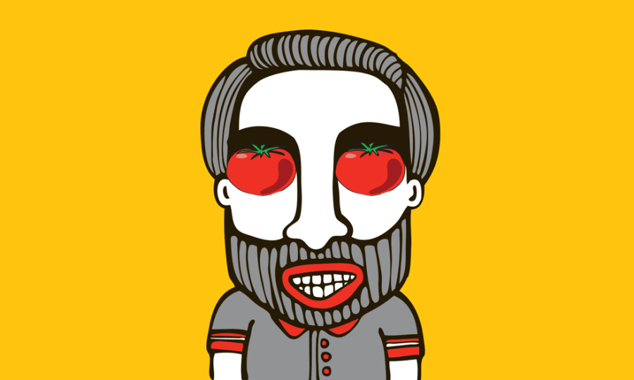
Idioms - German
The idiom: Tomaten auf den Augen haben. Literal translation: “You have tomatoes on your eyes.” What it means: “You are not seeing what everyone else can see. It refers to real objects, though — not abstract meanings.”
The idiom: Ich verstehe nur Bahnhof. Literal translation: “I only understand the train station.” What it means: “I don’t understand a thing about what that person is saying.’”
What’s an English version of this idiom?

Slide 19
Thai idioms
The idiom: เอาหูไปนา เอาตาไปไร่ Literal translation: “Take ears to the field, take eyes to the farm.” What it means: “It means ‘don’t pay any attention.’ Almost like ‘don’t bring your eyes and ears with you.’ If that were possible.”
The idiom: ชาติหน้าตอนบ่าย ๆ Literal translation: “One afternoon in your next reincarnation.” What it means: “It’s never gonna happen.”
What’s an English version of this idiom?

Slide 20
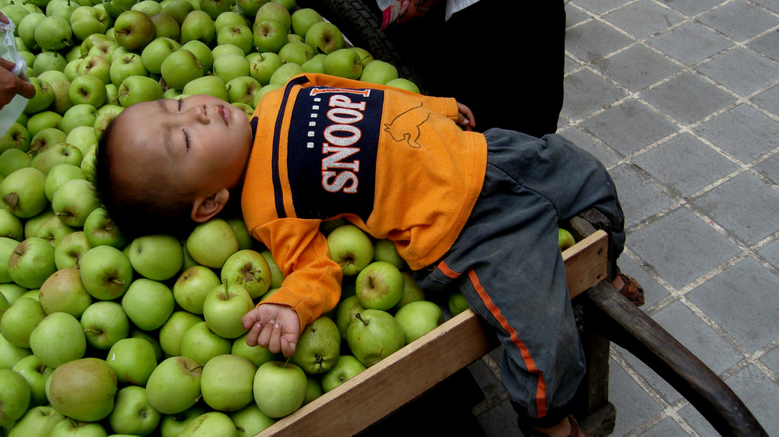
French idioms
The idiom: Tomber dans les pommes Literal translation: “To fall into the apples What it means: “To faint.”
The idiom: Les carottes sont cuites! Literal translation: “The carrots are cooked!” What it means: “The situation can’t be changed.”
What’s an English version of this idiom?

Slide 21
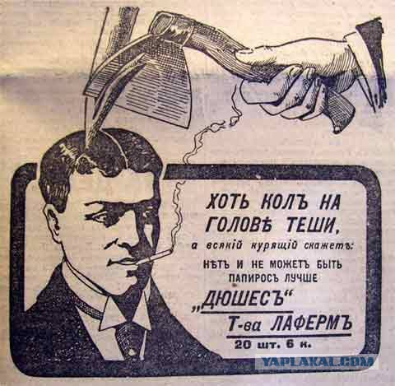
Russian idioms
The idiom: На воре и шапка горит Literal translation: “The thief has a burning hat.” What it means: “He has an uneasy conscience that betrays itself.”
The idiom: Хоть кол на голове теши Literal translation: “You can sharpen with an ax on top of this head.” What it means: “He’s a very stubborn person.”
What’s an English version of this idiom?

Slide 22
Quick Note
Any day that reading is assigned, you might have a quiz over it.
This is true throughout the year.
Usually reading quizzes focus on the previous night’s reading, but they can be over any part of the book.

Slide 23
Idiom index cards
On the lined side:
Write your idiom in large, legible print
Write your name at the bottom
On the blank side:
Draw a line down the middle
Label the bottom left “Literal”
Label the bottom right “Figurative”
Draw one illustration for each side
Color and/or outline in bold marker
10 points process category

