Slide 1
Semester 1 Integrated Paper: Latin American & European Folk Tales
Your task is to read and analyze the language of a European or Latin American folk tale, then construct an integrated, thesis-driven research paper examining the historical context, cultural significance, and purpose of your folk tale.
Two part essay – 500-700 words per section (1,000-1,400 total)

Slide 2
Countries and their folk tales
Argentina – “Rice from the Ashes”
Baltic states – “Three princes and their beasts”
Chile 1 – “The Enchanted Cow” and “The Parrot Prince”
Chile 2 - “Crystal the Wise”
Chile 3 – La Calchona
Cuba – “The nobleman’s daughter and the charcoal mother’s son”
Denmark – “The Little Mermaid”
France – “Beauty and the Beast”
Germany 1 – “Cinderella”
Germany 2- “Little Red Cap”
Ireland – “The Fate of the Children of Lir”
Mexico 1 – “La Llorona”
Mexico 2 - “Mistress Lucia”
Mexico 3 - “What the Owls Said”
Russia – “The Frog Princess”
Serbia/The Balkans – “Bash Chelik”
Venezuela – “El Silbon”

Slide 3
Semester 1 Integrated Paper: Latin American & European Folk Tales
You will write a two-part paper.
Each part will be guided by its own thesis statement.
The first half of your paper will analyze 19th century historical events in your assigned country
  To do this you will craft a (first) history-based research question, answer it with a thesis, and then create an outline detailing the facts and analysis that prove your thesis. You should base this in the themes of your tale.

Slide 4
Semester 1 Integrated Paper: Latin American & European Folk Tales
You will write a two-part paper.
Each part will be guided by its own thesis statement.
The second half of your paper will analyze the language of your folk tale, showing how plot, motifs, and historical diction create meaning for particular audiences
  You will craft a (second) literature-based research question about the story’s context and the cultural values the narrative conveys; then, you’ll answer your question with a thesis and then create an outline detailing the facts and analysis that prove your thesis.

Slide 5
Semester 1 Integrated Paper: Latin American & European Folk Tales
History:
Research the country of origin of your folk tale:
  Culture
  Social and political structures
Determine how this historical context is key to understanding your folk tale’s meaning.
Use credible sources
Cite your evidence correctly

Slide 6
Semester 1 Integrated Paper: Latin American & European Folk Tales
Language:
What is the purpose of your folk tale?
Are there any relevant themes present to teach the reader or listener a moral or lesson? Why?
Do you see any relevant motifs that keep appearing, or symbolism that stands out to you?
Examine constructions of race, class, gender, or other social commentary
Has the folk tale changed or evolved over time? Why?
Were elements of your folk tale lost or changed when they made the transition from oral tradition to written?
  How does this impact the meaning of the folk tale?

Slide 7
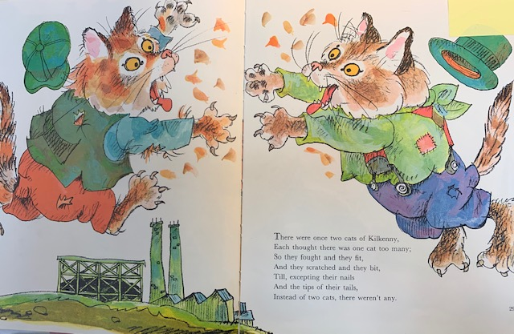

Slide 8
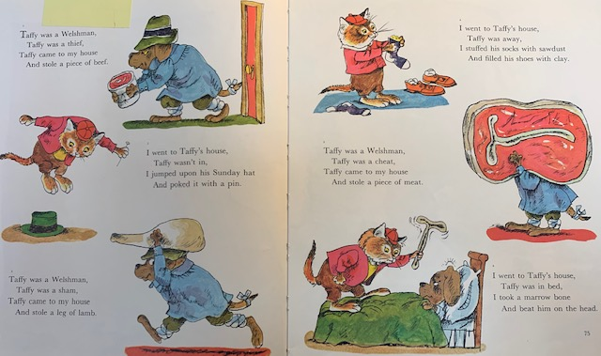

Slide 9
Analyze: How does the language of the folk tale reveal something about the context that it comes from? What message is it sending to its intended audience, and how?

Slide 10
The second half of your paper will analyze the language of your folk tale, showing the author creates meaning for a particular audience and purpose
The first half of your paper will analyze 19th century historical events in your assigned country
Part I Thesis Example:
Historically, inter-British prejudice fomented discord—both violent and private—and perpetuated socio-economic and political divisions that would fracture the British Empire.
Part II Thesis Example:
In “The Fairy Tales of Mother Goose, tales that use youthfully appealing rhyme and zoomorphism reinforce historical British prejudices, resulting in the intergenerational indoctrination of racist tribalism to literate children.

Slide 11
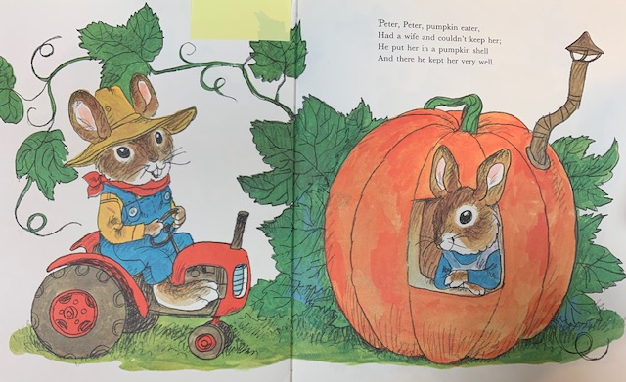

Slide 12
Countries and their folk tales
Argentina – “Rice from the Ashes”
Baltic states – “Three princes and their beasts”
Chile 1 – “The Enchanted Cow” and “The Parrot Prince”
Chile 2 - “Crystal the Wise”
Chile 3 – La Calchona
Cuba – “The nobleman’s daughter and the charcoal mother’s son”
Denmark – “The Little Mermaid”
France – “Beauty and the Beast”
Germany 1 – “Cinderella”
Germany 2- “Little Red Cap”
Ireland – “The Fate of the Children of Lir”
Mexico 1 – “La Llorona”
Mexico 2 - “Mistress Lucia”
Mexico 3 - “What the Owls Said”
Russia – “The Frog Princess”
Serbia/The Balkans – “Bash Chelik”
Venezuela – “El Silbon”

