Slide 1
Introductions and conclusions

Slide 2
Hook
Broad Context
Thesis
Introduction
Body Paragraph
Body Paragraph
Body Paragraph
Restate your thesis
Synthesize key ideas
(LA) Universal Application
Conclusion

Slide 3
Lit. analysis essays typically require an introduction with…
Hook – an interesting lead that grabs reader’s attention
Integrated quote
Anecdote
Interesting historical context
Context – a few sentences that set the situation for your essay
Author/famous figure bio
Reception of book when originally published
Historical context
Book overview/summary
Reception of book in today’s society
Current event that is connected and relevant
Thesis – clear statement that defines what your essay will be about

Slide 4
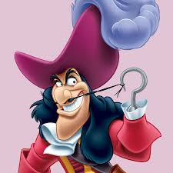
Introduction - HOOK
Hook –
DO NOT ASK A HYPOTHETICAL QUESTION!
“Have you ever wondered what impact Stalin had on the USSR?”
No, we haven’t.
Hypothetical questions are almost never effective.
And even if they were, we have seen so many bad ones that we have an aversion to them, so know your audience—and avoid.

Slide 5
Introduction - HOOK
Hook – an interesting lead that grabs reader’s attention. Be careful not to make this statement too broad or too specific.
Too Broad:
Some things in life seem destined to happen, regardless of what we do to try to stop them.
Too Specific:
In the play, Romeo and Juliet, the lovers are doomed from the start, and sure enough, end up dying by the play’s end.
Just Right:
Many of Shakespeare’s tragedies illustrate the concept that individual will is no match for pre-ordained fate.

Slide 6
Quote/Epigraph
You can use a quote as an epigraph or as your first sentence, but it must connect to your essay CLEARLY.
Do not leave me wondering “Why did they even include that?”
Do not drop a quote there and say nothing about it.
Choose a quote carefully.

Slide 7
Quote/Epigraph

Slide 8
Quote/Epigraph

Slide 9
Quote/Epigraph

Slide 10
Quote/Epigraph
“Memorable Quotes.” Munroe, Randall. XKCD. 2017, https://xkcd.com/1942/. Accessed 21 March 2018.

Slide 11
Introduction - CONTEXT
Context – a few sentences that set the situation for your essay.
Author bio
Reception of book when originally published
Historical context
Brief book overview/summary
Reception of book in today’s society
Current event that is connected and relevant
Example:
(HOOK) Many of Shakespeare’s tragedies illustrate the concept that individual will is no match for pre-ordained fate. (CONTEXT) - Romeo and Juliet is a classic Shakespearean tragedy in this sense. In it, the young lovers struggle to overcome many barriers in order to be together.

Slide 12
Introduction - THESIS
Thesis – clear statement that defines what your essay will be about. The thesis makes a claim about your topic or text, lays out key evidence to support this claim, and explains the significance of this.
Identifying thesis elements:
What
How
SO WHAT? WHY does this matter?

Slide 13
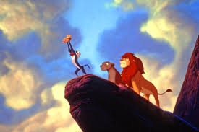
Introduction - DEVELOPMENT
Consider using a framing device.

Slide 14
Introduction - DEVELOPMENT: How to use a framing device?
1) single word/image/idea
2) literary/historical allusion,
3) historical narrative…
that can provide a fresh way into and out of your writing, surrounding it much like a window frame surrounds a glass pane or a decorative frame surrounds a picture or mirror.

Slide 15
Introduction - DEVELOPMENT: Why frame?
A carefully crafted frame can give a piece of writing a deeper sense of meaning and a way into and out of the assignment that escapes the over-used traditional patterns.
A carefully crafted frame can make satisfying metaphorical connections for both reader and writer, giving the paper a deeper sense of meaning and a way into and out of the assignment.
Use a frame-up in conjunction with your essay context setup, which you may also integrate with your hook.
Your frame should be at least somewhat related to your So What, and should not contradict it.

Slide 16
The Single-Word, Single-Image, Single-Idea Frame
Syndicated columnist William Safire often relies on a single word as a framing device. In a 1994 article, he calls on tsunami, the Japanese word for a "great wave caused by underwater seismic shock," to frame an article on the shock that caused the conservative wave of that year.
His introduction connects the definition of tsunami with the main idea of his article: the majority of voters "shook up" legislators to express their lack of faith in an ever-growing government.
The column ends with a second mention of the tsunami, identifying it as a shock that does indeed change everything and that leads to exciting days politically, an analogy that reinforces his (but not everyone's) opinion.

Slide 17
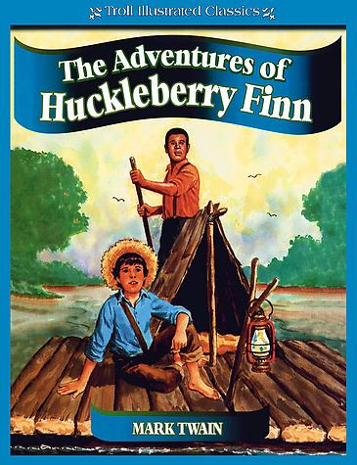
The Single-Idea Frame
Intro to Huck Finn essay – by S.S. 2016
At the beginning of a child’s life, 700 to 1000 new neural connections are made every second; meaning that a child takes in 700 to 1000 new pieces of information each second (HarvardCenter). …….Huckleberry Finn, a young boy growing up in a society where he is told what to think and how to behave, has had his groundwork laid by the active civilization around him. …..In his satirical novel, The Adventures of Huckleberry Finn, Mark Twain’s young protagonist, Huckleberry Finn, chooses a life of natural instincts in juxtaposition to a conventional upbringing, criticizing societal pressures to conform.

Slide 18
The Single-Idea Frame
Conclusion to Huck Finn essay -
Through the juxtaposition of nature and society, Twain condemns civilization’s pressures, which promotes Finn’s freedom of thought in The Adventures of Huckleberry Finn. In nature’s solitude, Finn processes his own experiences and makes his own conclusions. Though his upbringing may not be traditional, a journey through nature grants Finn with an opportunity to explore his thoughts without the noise of others. Each one of those 700 to 1000 connections in his brain are solely Huckleberry Finn’s, and in each second away from society an uneducated delinquent becomes smarter than any civilized adult.

Slide 19
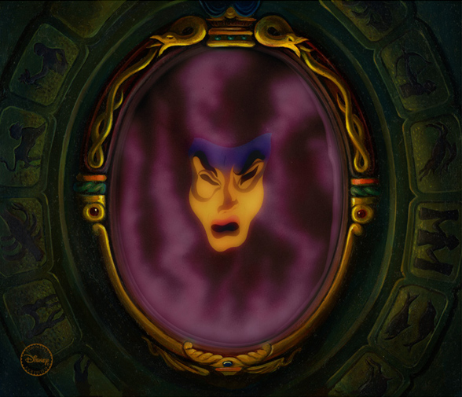
Allusions as Framing Devices
In an essay about healthy body image, a writer used the following allusion in her intro/conclusion: Snow White fairy tale
Intro - “I was obsessed with female beauty as the media portrays it. Every day I’d ask: Mirror, mirror on the wall, who’s the fairest of them all?”
Conclusion - “I no longer ask who’s the fairest, but instead I ask the mirror who’s the healthiest.”
NOTE: Do not use a personal/first-person POV in your research essay. This is just an example ☺

Slide 20
Personal Experience as a Framing Device
In a particularly effective paper on the negative impact television violence can have on children, one of student begins with a description of his family's extended Thanksgiving dinner.
The student explains that the peacefulness he felt as the family members gathered to give thanks vanished once he entered the family room where his younger cousins were mobilized in front of the television for the Power Rangers program. After watching intensely physical confrontations, the normally docile three- to twelve-year-olds turned into "miniature fighting machines." They eagerly kicked and punched any interloper, forcing the narrator to leave and question the laissez faire child-rearing attitudes of the children's parents.
This incident acts as a segue that connects the family experience with his topic: the growing problem of children's viewing of TV violence and possible solutions to this problem. The writer concludes by offering a plan for handling the situation at the next Thanksgiving dinner: "I may not be the most popular cousin for turning off the Power Rangers, but what is popular is not always right, and what is right is not always popular. I can live with not being popular.“

Slide 21
Historical Experience as a Framing Device
If you have researched a specific historical story that helps illustrate your argument, you can embed it into your intro/conclusion in a similar way.

Slide 22
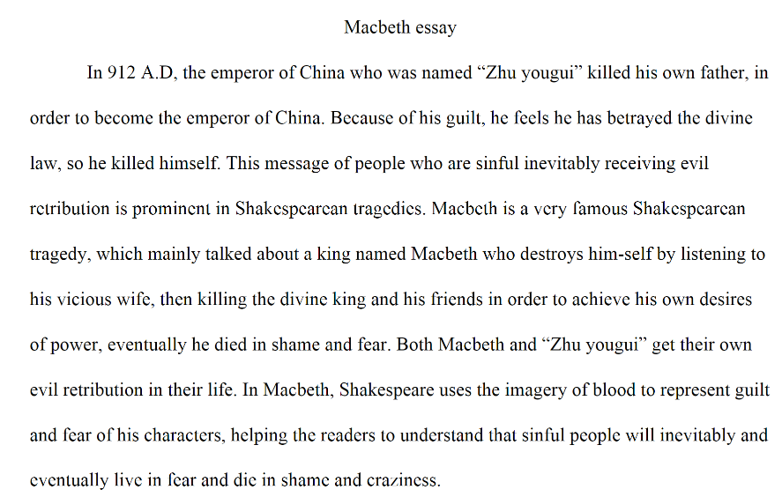

Slide 23
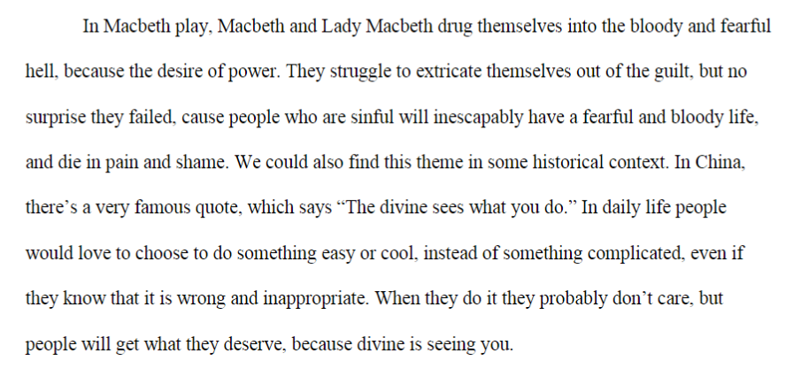

Slide 24
WARNING
Do NOT let your framing device run away with/overpower your introduction.
It should be BRIEF, only enhancing the context setup and thesis.

Slide 25
Conclusion Development
A conclusion should…
stress the importance of the thesis statement
give the essay a sense of completeness
leave a final impression on the reader.

Slide 26
Conclusion Suggestions
Answer the question "So What?"
Show your readers why this paper was important. Show them that your paper was meaningful and useful.
Synthesize, don't summarize
Don't simply repeat things that were in your paper. They have read it. Show them how the points you made and the support and examples you used were not random, but fit together.

Slide 27
Conclusion Suggestions
Redirect your readers
Give your reader something to think about, perhaps a way to use your paper in the "real" world. If your introduction went from general to specific, make your conclusion go from specific to general.
Create a new meaning in a Universal Application
You don't have to give new information to create a new meaning. By demonstrating how your ideas work together, you can create a new picture. Often the sum of the paper is worth more than its parts.

Slide 28
Be Careful!
Even if your conclusion offers “a way to use your paper in the real world,” do NOT use the word ‘you’ or ‘we’ or any other personal pronoun ANYWHERE in your essay!
This evidence shows us that we should be wary of power. NO
This evidence reveals that power is a dangerous force. YES

Slide 29
Hook
Broad Context
Thesis
Introduction
Body Paragraph
Body Paragraph
Body Paragraph
Restate your thesis
Synthesize key ideas
[LA - Universal Application/Theme]
Conclusion

Slide 30
How to embed a quote:
Find a way to introduce the quote INSIDE a sentence, instead of placing it alone.
Before (not embedded – two sentences):
Achebe characterizes Okonkwo as aggressive to show that his main motivation in life is appearing strong. “Perhaps down in his heart Okonkwo was not a cruel man. But his whole life was dominated by fear, the fear of failure and weakness” (Achebe 14).
After (good embedding):
Achebe characterizes Okonkwo as aggressive to show that “down in his heart Okonkwo was not a cruel man. But his whole life was dominated by fear, the fear of failure and weakness” (Achebe 14). This shows his main motivation in life is appearing strong.
Better embedding:
Achebe characterizes Okonkwo as aggressive, although “down in his heart [he] was not a cruel man” (Achebe 14). However, “his whole life was dominated by […] the fear of failure and weakness” and this motivation to appear strong drives the plot of the story.

Slide 31
How to embed a quote:
Use embedding to avoid repeating information.
Before (not embedded):
Okonkwo’s father is lazy, and so he does not have any advantages to start his life. “With a father like Unoka, Okonkwo did not have the start in life which many young men had” (Achebe 9).
Notice how this example repeats the same information. Find a way to make the quote speak for itself.
Embedded (basic):
In the beginning of the novel, Achebe shows that “With a father like Unoka, Okonkwo did not have the start in life which many young men had” (Achebe #).
Embedded (Advanced):
Early in the novel it becomes clear that Unoka is so lazy that “Okonkwo did not have the start in life which many young men had” (Achebe #).

Slide 32
Quote embedding tips
DO NOT!
. . . use quotes to repeat the same thing you’ve written:
Boxer believes that Napoleon is always correct. He says, “Napoleon is always right” (X). NOOOOOOOOOOOOOOOOO
>> Boxer believes that “Napoleon is always right” (x). Good!
DO NOT!
. . . use quotes that are very long.
You want to focus on the section of the quote that makes your point. Use an ellipsis […] whenever a part of a sentence is omitted.
Use paraphrasing to sum up a long part of the quote, then quote the important words.

Slide 33
Quote embedding tips
DO!
Use quote embedding to provide Context - explain what’s happening.
This can be very brief:
Snowball suggests building a windmill to power the farm, and that it “could all be done in a year” (Orwell 5) but Napoleon maintained that “the great need of the moment was to increase food production” (Orwell 6).
You can also use transitions:
In the beginning, the Commandment reads, “No animal shall sleep in a bed” (Orwell 20). But by the end, the animals realize it reads, “No animal shall sleep in a bed with sheets” (Orwell 60). They blame their poor memories for the change.

Slide 34
Quote embedding tips
DO NOT
…use 1st or 2nd person pronouns in your formal literary papers.
No I/me/we/us/you
I will prove that / as you can see / It is my opinion that / I believe that NO
Try to start avoiding phrases like…
This quote shows / This shows that / This proves that
It says on page 63 / In the book it says
But if you are thinking, “I want to embed quotes but I am not sure how else to do it,” then keep using these as you develop those skills ☺

Slide 35
Quote embedding tips
DO NOT
Connect two complete sentences with just a comma. THAT IS A COMMA SPLICE! Don’t do it!
BAD EXAMPLE – don’t do this!:
Okonkwo loves Ezinma, “If Ezinma had been a boy I would have been happier” (Achebe 54). Those are two different sentences, so you cannot just join them with a comma! This is not embedding.
HOW TO FIX IT:
Okonkwo loves Ezinma, and thinks to himself, “If Ezinma had been a boy I would have been happier” (Achebe 54).
Okonkwo thinks to himself that if Ezinma had been born a boy, he “would have been happier” (Achebe 54).

Slide 36
Quote embedding tips
DO NOT
Create a sentence that does not make grammatical sense. The whole thing should still flow as a normal sentence, even with the quote.
BAD EXAMPLE – don’t do this!:
When the time comes for Ikemefuna to go into the forest, “looked back, and the man growled at him to go on” (Achebe 13).
HOW TO FIX IT – always read the sentence and make sure it flows:
When the time comes for Ikemefuna to go into the forest, Ikemefuna “looked back, and the man growled at him to go on” (Achebe 13).

