Slide 1
Macbeth In-Class Essay overview
G10-19-20

Slide 2
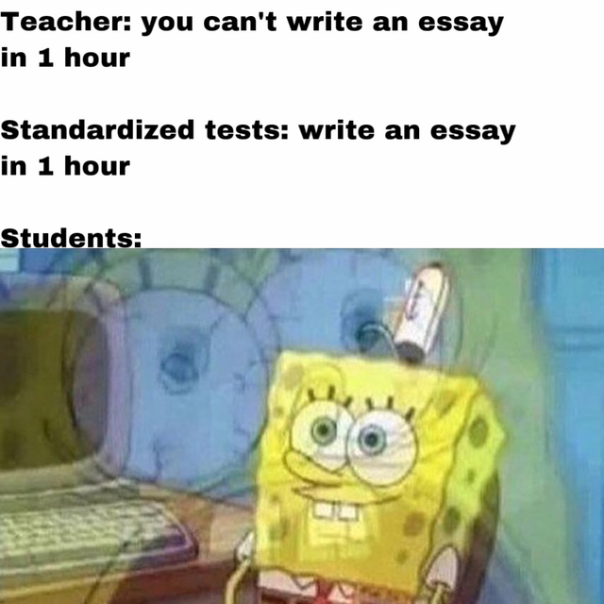
In-Class Essay Feedback

Slide 3
Week overview

Slide 4
Literary Analysis essay
This essay is essentially the same task as any other literary analysis essay (such as you may have written for Things Fall Apart or Bless Me, Ultima
The only difference is the writing time frame.
Because you are asked to write it all at once, the standards for some skills will be lightened – for example, spelling
However, because you have a week to prepare and know the prompts in advance, you will still be held to the same general standards on the common Humanities rubric.

Slide 5
Final essay parameters
60 minutes total
50 points in the Culminating category
You may bring:
Your book + any sticky notes or similar that you have put inside
Your Macbeth packet
One piece of paper, no larger than 8.5x11”, with notes and/or quotes and/or an outline - HANDWRITTEN
A written-out thesis
You may not bring:
A pre-written essay

Slide 6
thesis
Your thesis must answer a prompt and make an argument.
It must have three parts:
What - What is the author writing about? What is the subject?
How - How does the author write about their subject? That is—what literary elements or techniques do they use to create their message?
So What - Answer the question: So What? Why does this matter? What was the author trying to do by using that What and How? What is the author’s message?
Sometimes this is called your ‘argument depth.’

Slide 7
thesis
Your thesis will be graded at the same level of rigor that would be used in a full essay.
Make sure you have a strong, complete thesis ready to go when you walk in the door Tuesday.

Slide 8
Evidence
You must have direct quotations from the play that support your thesis.
Make sure every single quote has an example of your “how”
For example, if your ‘how’ is bird imagery, you need to make sure every quote includes bird imagery.

Slide 9
Evidence
“Context” means explanation of the situation surrounding the quote.
For example:
After committing the ghastly murder of King Duncan, Macbeth hesitates to return to the scene of the crime. He tells Lady Macbeth, “I’ll go no more” (2.2.65).
Assume your reader has not read the play. Don’t over explain, but do give brief explanations for context.

Slide 10
Evidence
If you have errors in your MLA in-text citations, you will be marked Approaching Standards.
If you do not include MLA in-text citations, you will be marked Below Standard on Evidence.

Slide 11
Analysis
Most of all, ensure that your analysis…
Examines the language of the evidence, focusing on the how
Connects each quote back to your So What
It should logically explain how each quote proves your So What correct

Slide 12
Organization
You do not need an introduction, conclusion, or Works Cited page.
We will work on those skills in our longer essays.
That means developing BTSs (Body Thesis Statements) is essential for this category.
We will have a specific mini-lesson on this at the end of class.

Slide 13
language
QUOTE EMBEDDING
Embed your quotes into sentences to meet or exceed standards.
Approaching Standard: After committing the ghastly murder of King Duncan, Macbeth hesitates to return to the scene of the crime. “I’ll go no more” (2.2.65).
Meets Standard: After committing the ghastly murder of King Duncan, Macbeth hesitates to return to the scene of the crime. He tells Lady Macbeth, “I’ll go no more” (2.2.65).
Exceeds Standard: After committing the ghastly murder of King Duncan, Macbeth hesitates to return to the scene of the crime, telling Lady Macbeth, “I’ll go no more” (2.2.65).

Slide 14
language
Spelling / Punctuation / Grammar
Minor spelling errors will not affect your grade, but contractions, personal pronouns (I/you/me/we/us), informal language, and significant spelling errors (for example, spelling Macbeth wrong every time) will be marked as Approaching or Below Standards on Language.
Not a big deal: spelling ‘necessary’ as ‘neccessary‘
Big deal: You might think Mcbath is great well he isn’t he’s super sus and kind of a bruh moment.

Slide 15
language
Spelling / Punctuation / Grammar
No contractions
No personal pronouns (I/me/we/you etc)- 1st/2nd person
Fine to use 3rd person: He, she, it, they, them, her, his, etc
No slang or casual phrasing

Slide 16
language
Avoid run-ons and comma splices
If a sentence can stand on its own, it cannot be attached to another sentence – that’s a run-on
I love my dog she is cute.
You can’t even attach them with just a comma. That’s called a comma splice.
I love my dog, she is cute.
Here’s how you would phrase those:
I love my dog because she is cute. (Add a conjunction)
I love my dog. She is cute. (Break them apart)

