Slide 1
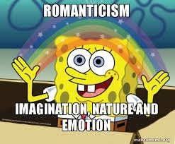
Romanticism

Slide 2
Romanticism – Context and concepts take notes on the back of your graphic organizer

Slide 3
(Approximate) Timeline
Middle Ages = 476 AD – 1490 --> Over 1000 years!
Renaissance = 1300 – 1600 --> 300 years
Enlightenment = 1658-1815 ---> 157 years
Romanticism = 1780 - 1850 --> 70 years

Slide 4
Historical Context - Catalysts
The Enlightenment: 1658-1815
“The Age of Reason” celebrated logic as literacy spread across Europe.
British Industrialization: 1770-1850
The economy of England changed from mostly agricultural to mostly industrial.
French Revolution: 1787-1799
Marks the decline of powerful monarchies and churches and the rise of democracy and the power of the people in France and throughout many parts of the world.

Slide 5
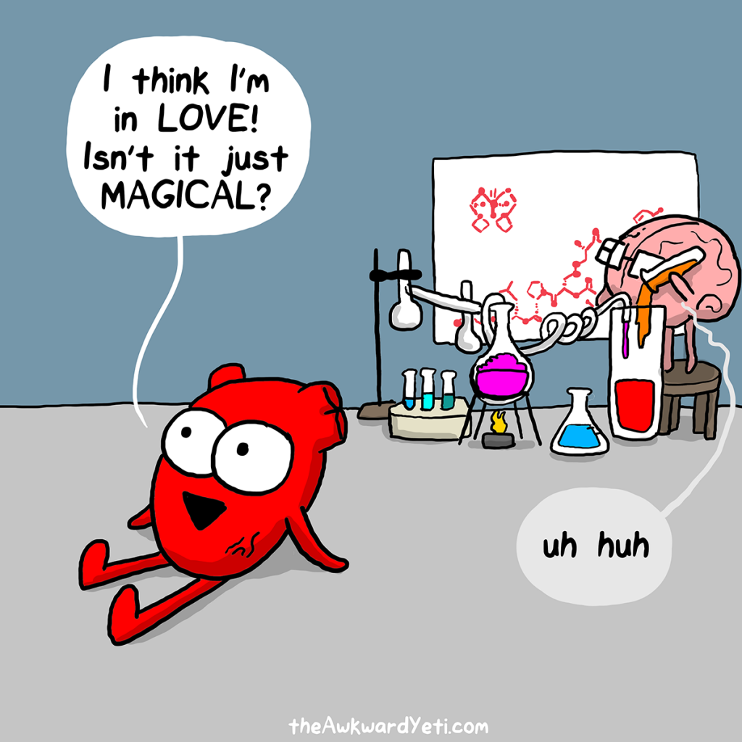
Context Reaction - The Enlightenment
The Enlightenment: 1658-1815
“The Age of Reason” celebrated logic as literacy spread across Europe
Enlightenment philosophers
Logic > Feelings
Romantics
Feelings > Logic

Slide 6
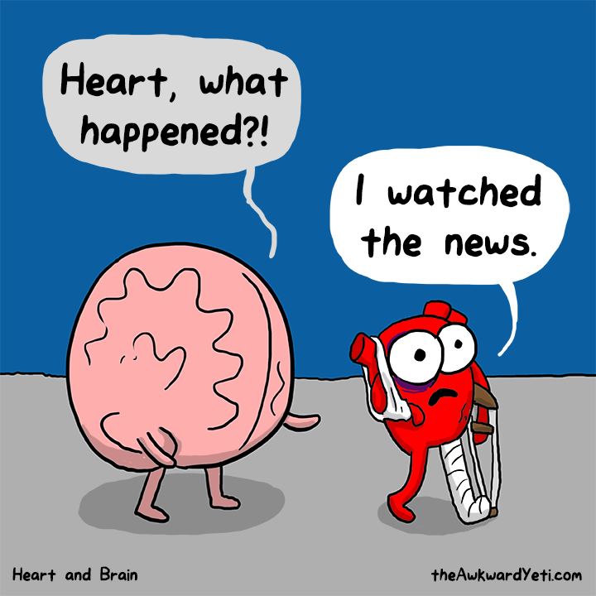
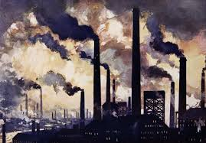
Context Reaction - Industrial Revolution
British Industrialization: 1770-1850
The economy of England changed from mostly agricultural to mostly industrial.

Slide 7
Context Reaction - Industrial Revolution
The Industrial Revolution brought increased quality of life, but Romantic authors could not help but notice the horrors of industrialism:
urban squalor: poor living conditions
a polluted natural and work environment, lack of education, inability to move up the social ladder
the alienation of people from nature and nostalgia for the simplicity found within a more agrarian lifestyle
Romantics thought a return to nature could solve some of these problems.

Slide 8
Context Reaction - French Revolution
French Revolution: 1787-1799 - Marks the decline of powerful monarchies and churches and the rise of democracy and the power of the people.
Nobility of conflict
Daring to take down “the man” even in a horrible fashion, felt good.
Nationalism
Emphasis on the importance of and love for one’s country was key when modern states began to emerge

Slide 9
Context Reaction - French Revolution
Idealism and natural rights
Dreamed a Romantic ideal of what life could be
Daring, individual, and imaginative approach to both literature and life
Human Worth & Individualism
First time ordinary people became the protagonist of the historical process on a large scale
Value of human life for the common people was emphasized for the first time

Slide 10
Romanticism in Art
Look at each of the pictures -
Write down your reactions:
What do you notice immediately? Colors, focus, shading, etc.
What do you notice after looking for awhile?

Slide 11
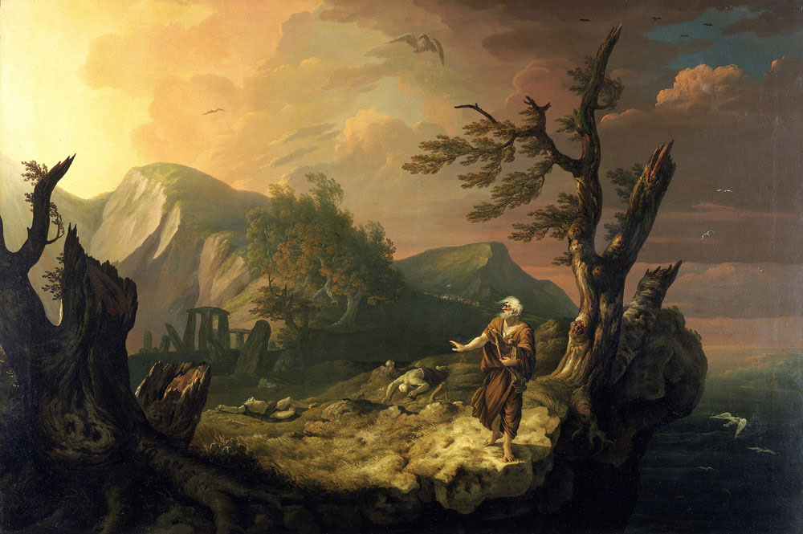
“The Bard”,
Jones

Slide 12
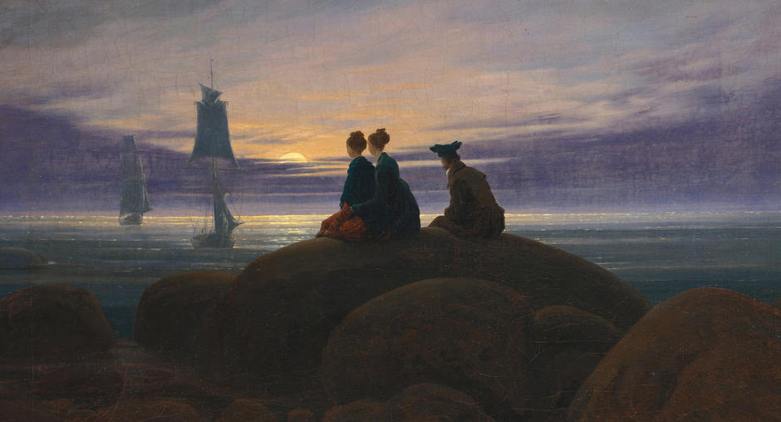
“Moonrise Over the Sea” Friedrich

Slide 13
The Romantic Period
The Romantic age brought a more daring, individual, and imaginative approach to both literature and life.
The individual rather than society was at the center of Romantic vision.
Romantic writers tended to be optimists who believed in the possibility of progress and social and human reform.
As champions of democratic ideals, they sharply attacked all form of tyranny and the spreading of evils of Industrialism. Such as:
urban blight, a polluted environment,
and the alienation of people from nature and one another.

Slide 14
What is Romanticism?
In reaction to the rational poems and subjects of the Enlightenment; the Romantics were bold, energetic, full of emotion and reconnected with the natural world.
For most of the Romantic poets, nature was the principal source of inspiration, spiritual truth, and enlightenment.
The literature of the Romantic age has a sense of:
Uniqueness of the individual,
A deep personal earnestness,
A sensuous delight in both the common and exotic things of this world,
A blend of intensely felt joy and dejection,
A yearning for ideal states of being,
A probing interest in mysterious and mystical experience.
Romanticism even changed fashion.

Slide 15
The Romantic Characteristics
Seeking the unusual, haunting, and gothic;
Placing emotion over reason; “revolting” against science and logic and “worshipping” our feelings;
Celebrating the individual and individual rights and freedoms;
Liberating the unconscious; speaking our innermost thoughts freely;
Celebrating nature; “returning to nature” in the lives and songs of men.
Showing strong concern for society and politics and the freedoms of mankind.

Slide 16
Romanticism Writing Style
Write on the back of your graphic organizer
Tone: Story is “told” vs. “shown”
Figurative Language (FL): Hyperbole! Other FL used to exaggerate and emphasize.
Syntax: Literary/formal. Older techniques.
Diction: Literary/formal. Highlights the speaker.
Imagery: used to emphasize characteristics. Focus on the power of the individual, imagination, and expression.

Slide 17
Romanticism.... In one quote.
“The spontaneous overflow of powerful feelings”
Adapted from Readwritethink.org
http://www.readwritethink.org/classroom-resources/lesson-plans/exploration-romanticism-through-poetry-1142.html?tab=4

Slide 18
Realism

Slide 19
Romanticism vs. Realism: values
Romanticism
The world is simpler and more beautiful when you have a connection to nature.
Emotional expression is best when it is exaggerated to prove your intensity and passion.
We should focus on the amazing details of life and glorify the beauty of nature, especially man’s connection to it!
Realism
The world is complex and cannot be simply described.
Emotional expression should be realistic in order to reveal the importance of relationships.
We should focus on the seemingly insignificant details to illuminate the complexities of man and society!

Slide 20
Romanticism vs. Realism: Characteristics
Romanticism
Interest in the common man and childhood
Strong senses, emotions, and feelings
Awe of nature
Celebration of the individual and imagination
Realism
Focus on details about the common man
Character’s attitude and actions are legitimate topics of literature
Nature is described literally
Exploration of seemingly insignificant details to reveal important complexities

Slide 21
Romanticism vs. Realism: techniques
Romanticism
Unrealistic Characters
Character is a “god”
Plot is unusual events, mystery, high adventure
Story is “told”
Exaggeration
Setting is for plot
The language is often “literary” (formal)
Realism
Realistic characters
Characters are normal people
Plot is ordinary events
Story is “shown”
Objectivity
Setting is for characterization
Writer uses everyday, “normal speech

Slide 22
Realism writing style
Write on the back of your graphic organizer
Tone: Story is “shown” vs. “told”
Figurative Language (FL): Rarely used
Syntax: Plain and direct; never ‘flowery’
Diction: Focused on everyday life
Imagery: Description of details used to show the reality of everyday life – emphasis is on characters, setting, plot

Slide 23
Realism: focus on the ordinary
Focus on everyday activities instead of romanticized, stylized interpretations
Characters resemble ordinary people
Realism is interested in recent or contemporary life
(Romantics loved looking to historical legends and ancient artists)
Hyperfocus on details to illuminate the world’s complexities

Slide 24
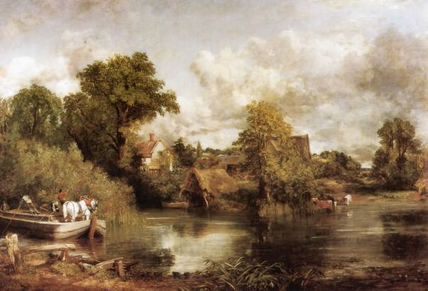
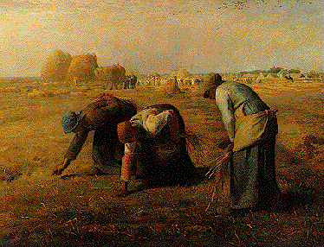
White Horse - Constable
The Gleaners, 1857 Jean-François Millet
Romantic
Realist

Slide 25
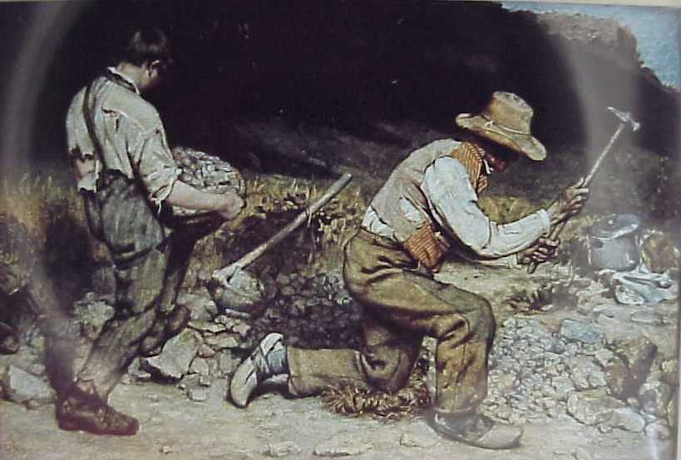
Courbet The Stonebreakers
REALIST
Men are ordinary
Ordinary events

Slide 26
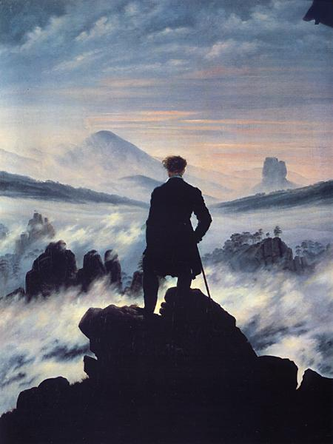
Friedrich – Wanderer
ROMANTIC
Man as “god”
Mysterious
Nature!

Slide 27
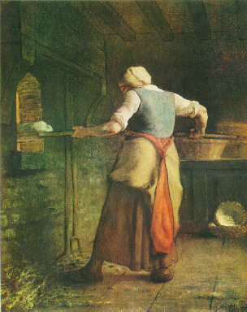
Millet – Woman Baking Bread
REALIST!

Slide 28
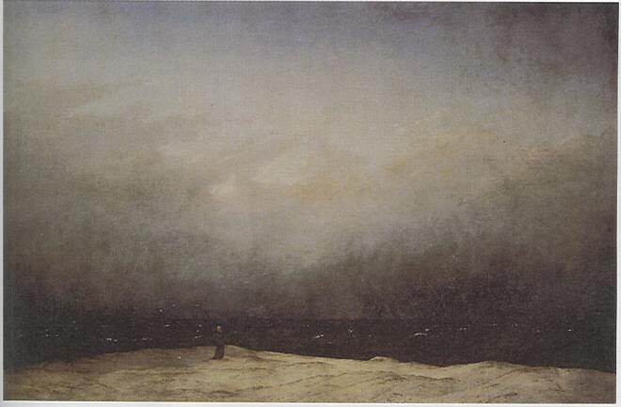
Friedrich - Monk by the Sea
ROMANTIC!
(look at that nature…)

