Slide 1
Surrealism:
Letting go of ‘reality’

Slide 2
What is surrealism?
A Modern artistic movement started in the early 1900’s by Andre Breton (French Writer)
The movement was embraced by many artists as a way to process and comment on the horrors of World Wars I & II

Slide 3
What do Surrealists believe?
The purest form of expression is found in the unconscious.
You need to break boundaries when creating art (writing, painting, etc.)
Things don’t need to ‘make sense’ to the conscious mind.

Slide 4
What do Surrealists believe?
Table groups: Draw connections between Modernism and Surrealism.

Slide 5
Salvador Dali-
Surrealist Painter

Slide 6
Salvador
Dali

Slide 7
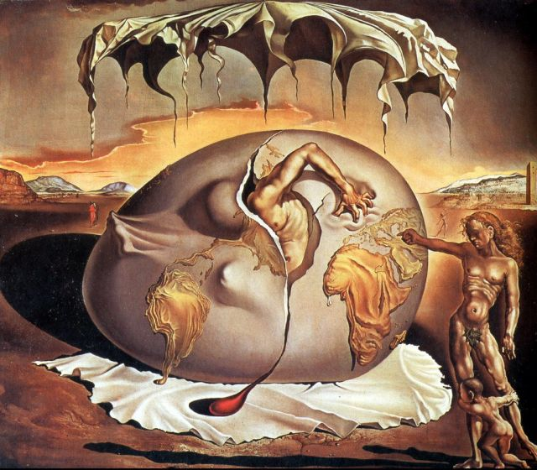
Salvador
Dali

Slide 8
Salvador
Dali

Slide 9
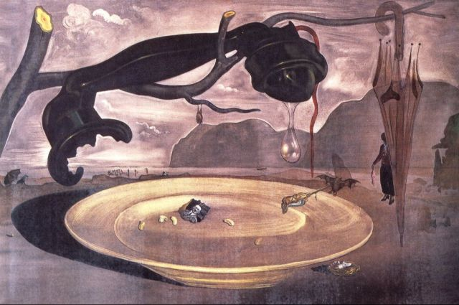
Salvador
Dali

Slide 10
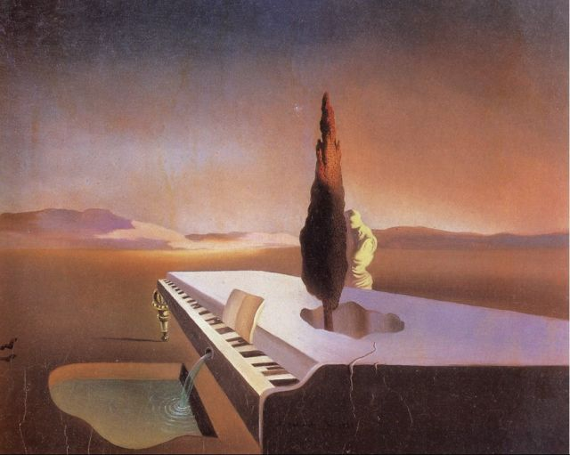
Salvador
Dali

Slide 11
Salvador
Dali
The Persistence of Memory
Table group discussion: How does this painting reflect Surrealism? How does its title reflect Surrealism?

Slide 12
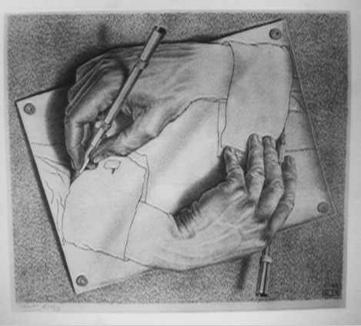
M.C. Escher

Slide 15
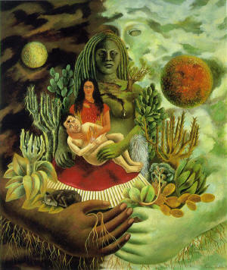
Frida Kahlo

Slide 16
Frida Kahlo

Slide 17
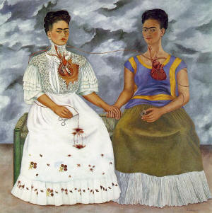
Frida Kahlo
“They thought I was a Surrealist, but I wasn't. I never painted dreams. I painted my own reality.”

Slide 18
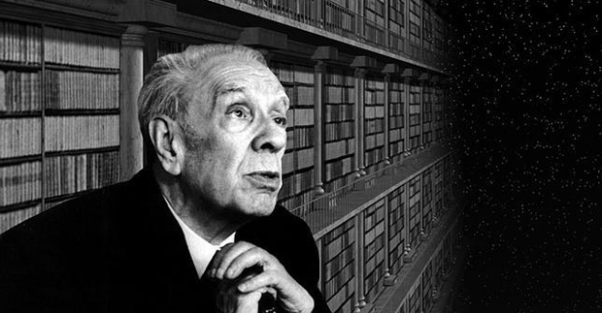
Jorge Luis Borges (1899-1986)

Slide 19
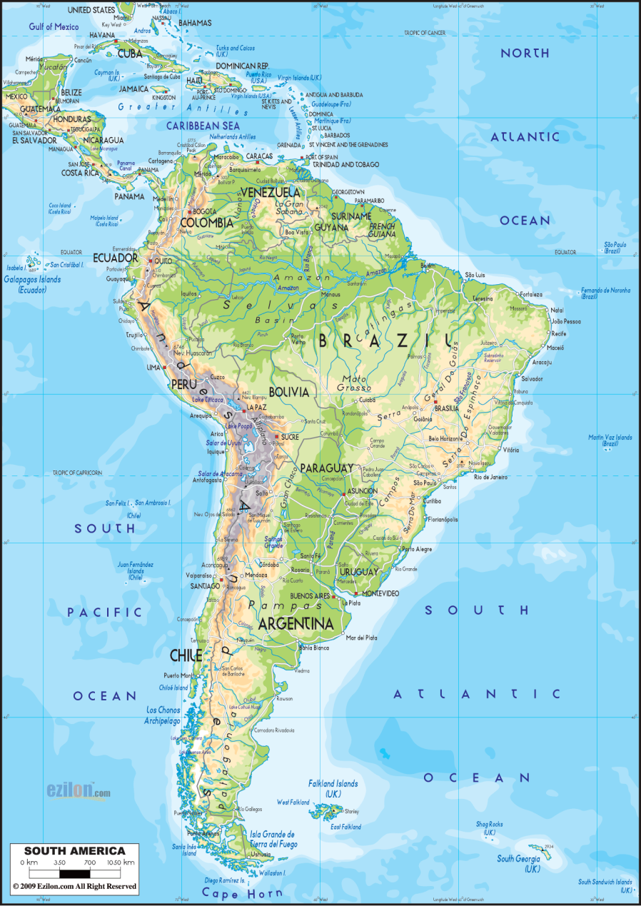
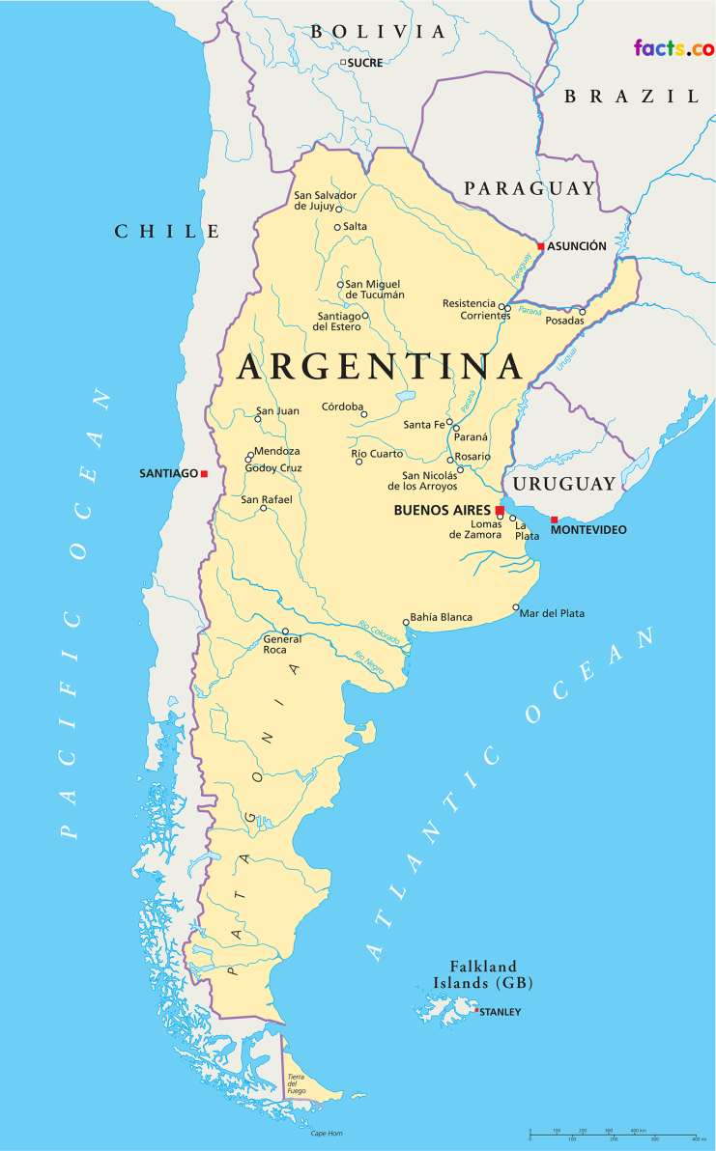
Argentina

Slide 20
A Quick Overview
Born August 24, 1899; died June 14, 1986
Considered one of the foremost literary figures of the 20th century.
Best-known in the English speaking world for his short stories and essays
also a poet, critic, and translator.
Influenced by authors such as Dante Alighieri, Jonathan Swift, Franz Kafka, and Rudyard Kipling.

Slide 21
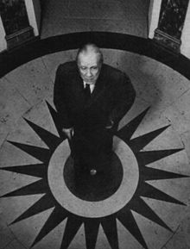
Life of Jorge Luis Borges
Lived most of his life in Buenos Aires
Fluent in both Spanish and English
Began to lose his eyesight in his 30s
Completely blind by 55
Lost ability to read without his mother’s help
1938 Suffered a severe head injury which affected his speech and marked the beginning of his most productive writing
Shift in style to ironical and paradoxical dreamworld with own language and symbols
Died of liver cancer

Slide 22
Purpose
Borges's fictional universe was born from his vast and esoteric readings in literature, philosophy, and theology.
He sees man's search for meaning in an infinite universe as a fruitless effort. In the universe of energy, mass, and speed of light, Borges considers the central riddle time, not space.
"He believed in an infinite series of times, in a growing, dizzying net of divergent, convergent and parallel times.”

Slide 23
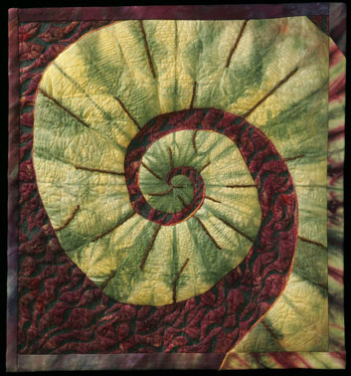
Popular Borges Motifs: The Labyrinth and The Mirror
Borges told in an interview that when he was a boy, he found an engraving of the seven wonders of the world, one of which portrayed a circular labyrinth. It frightened him and the maze has been one of his recurrent nightmares. The maze often symbolizes his perception of free will and provides a non linear quality to his work.
Another recurrent image is the mirror, which reflects different identities. The idea for the short story 'Borges y yo’ came from the double, who was looking at him - the alter ego, the other I.

Slide 24
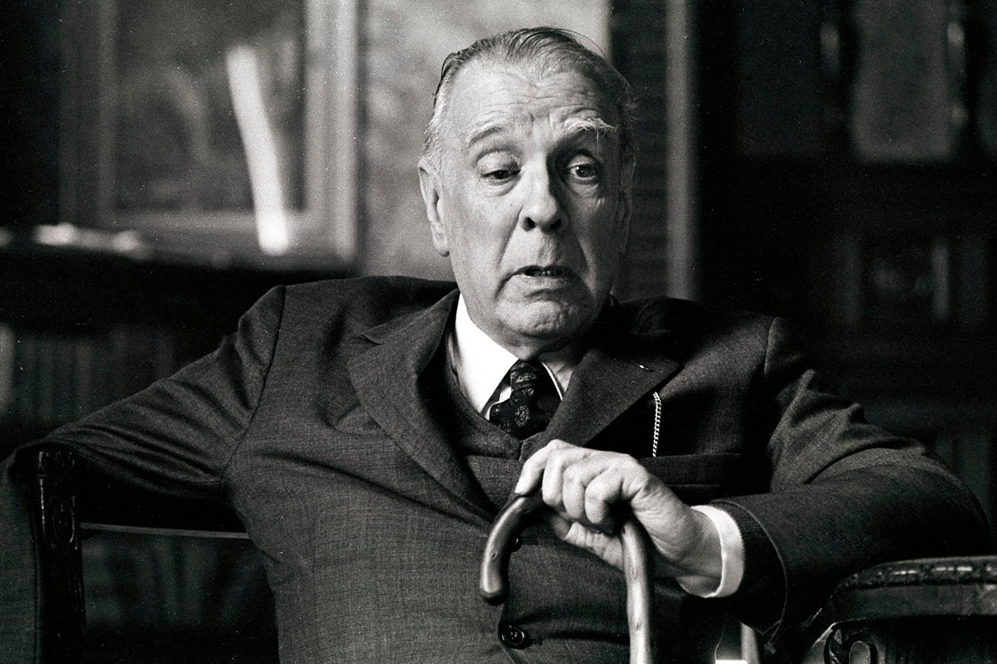
On Time and Destiny:
"Our destiny is not horrible because of its unreality; it is horrible because it is irreversible and ironbound. Time is the substance I am made of. Time is a river that carries me away, but I am the river; it is a tiger that mangles me, but I am the tiger; it is a fire that consumes me, but I am the fire. The world, alas, is real; I, alas, am Borges."

