Slide 1
Confucius / Confucianism

Slide 2
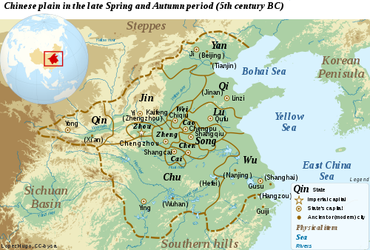
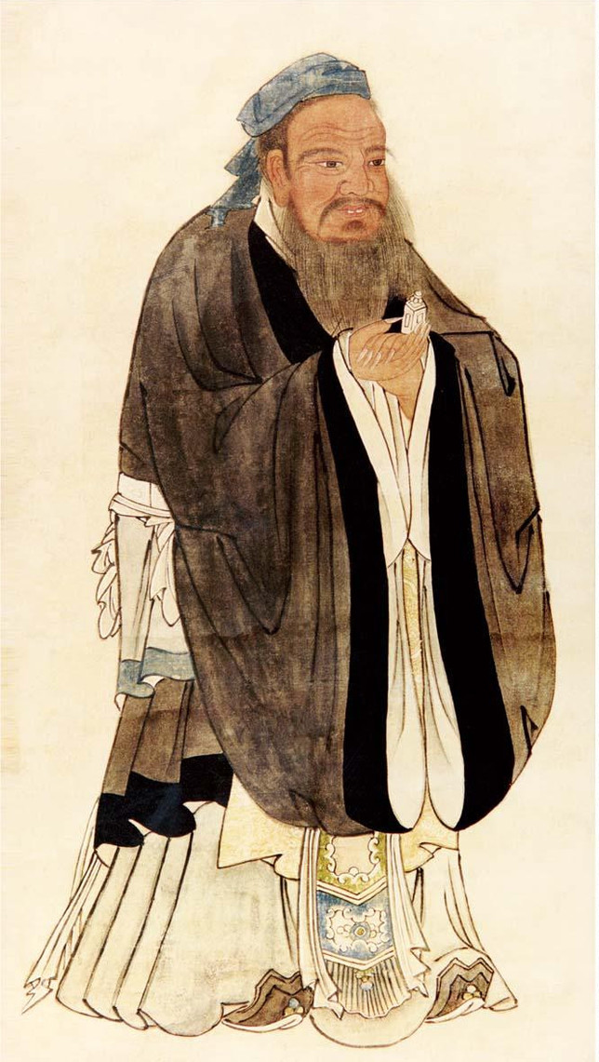
Confucianism
儒教
Called "Rú jiào" - Ruism
Rú: scholar
jiào: doctrine/religion
Founder: Kongzi (Master Kong) → Confucius (Latinized)
551 BCE – 479 BCE
Lived during Spring and Autumn Period / Warring Period in China
Lots of chaos, violence, different kingdoms/states fighting each other
From a aristocratic family in the state of Lu (N. China)
Believed he discovered the solution for social harmony

Slide 3
Confucianism
儒教
In Mandarin: "Rú jiào" - Ruism
Rú: scholar
jiào: doctrine/religion
Founder: Kongzi/ "Kǒng Fūzǐ" (孔夫子, Master Kong) → Confucius (Latinized)
551 BCE – 479 BCE
Lived during Spring and Autumn Period / Warring Period in China
Lots of chaos, violence, different kingdoms/states fighting each other
From a aristocratic family in the state of Lu (N. China)
Believed he discovered the solution for social harmony

Slide 4
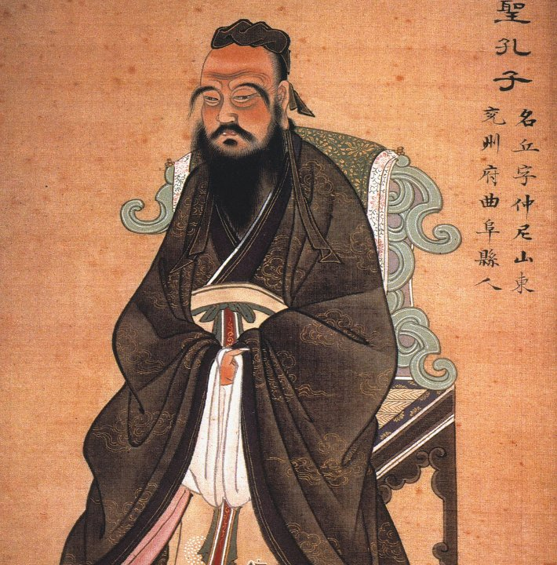
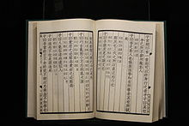
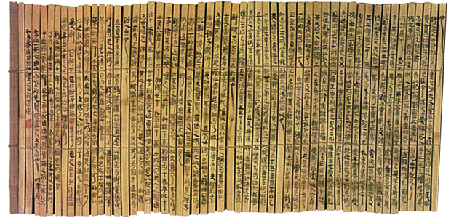
Confucianism
Spent most of his adult life wandering around China
Looking for a leader who would adopt his philosophy
No one was interested...
After his death – his students wrote down his teachings in a book called the Analects
Idea becomes more popular – Chinese rulers began to adopt his philosophy into practice
Spreads throughout China & neighboring countries (Korea, Japan, and Vietnam)
儒教

Slide 5
Confucianism
儒教
Focused on human behaviors in everyday life not beliefs about any deity
Philosophy for this life, not a religion
Social harmony could be attained by moral examples by superiors
Looking up to elders
Looking back to the past for these examples

Slide 6
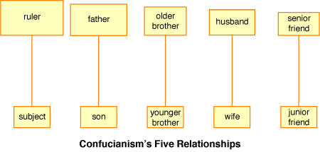
Confucianism
Human society consist of unequal relationships – normal & natural
儒教

Slide 7
Confucianism
儒教
If the Superior party behaves with sincerity, benevolence, and genuine concern for others
Inferior party will respond with deference and obedience
Harmony

Slide 8
Confucianism
“The relationship between superiors and inferiors is like that between the wind and the grass. The grass must bend when the wind blows across it”

Slide 9
Journal 29.2
In what ways do your family’s values reflect, or not reflect, Confucian values?

Slide 10
Confucianism
仁
Believes in the cultivation of “ren”
Human virtue
Translated as “human-heartedness, benevolence, goodness, nobility of heart, humanity”
Humans are all born with ren, and are intrinsically good
negative leaning and experiences suppress the good nature
Essential ingredient of a tranquil society
Ren relies on 2 people

Slide 11
Confucianism
History & education
Studying history is important to learn from the model of great rulers
Education is important
Patriarchy
The universe/cosmos is hierarchical and gendered
Heaven → male
Earth → female
Justifies female subordination to male.
Educate girls so they could better serve their husbands
Educate boys so they could be better contributors to society

Slide 12
Confucianism
filial piety (xiào)
Virtue of respect for one’s parents, elders, and ancestors
Obeying your parents in life, taking care of them in old age, and honoring them in death
Ultimate duty in life
Relates to the 5 unequal relationships
The family is the center and model for society
Ruler → father of the nation
Subject → children
孝

Slide 13
Confucianism
filial piety (xiào)
Virtue of respect for one’s parents, elders, and ancestors
Obeying your parents in life, taking care of them in old age, and honoring them in death
Ultimate duty in life
Relates to the 5 unequal relationships
The family is the center and model for society
Ruler → father of the nation
Subject → children
孝

Slide 14
Confucianism
Does Confucianism have a fundamentally optimistic or pessimistic view of human nature?
孝

Slide 15
Confucianism
Read 437-438
Pay close attention to the footnotes
Reflect on each maxim and make sure you can paraphrase them if called upon
孝
仁

