Slide 1
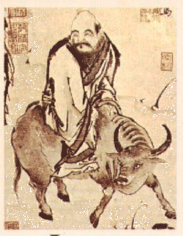
Daoism/Taoism
Called dàojiào 道教
“the teachings of the Dao/Tao”
Founder: Laozi
Semi-Legendary figure
Traditional accounts said he was alive around the 6th century BCE – a contemporary of Confucius
Some historians say that he was from the 5th or 4th century BCE (after Confucius)

Slide 2
Daoism/Taoism
Called dàojiào 道教
“the teachings of the Dao/Tao”
Founder: Laozi
Semi-Legendary figure
Traditional accounts said he was alive around the 6th century BCE – a contemporary of Confucius
Some historians say that he was from the 5th or 4th century BCE (after Confucius)

Slide 3
Daoism/Taoism
道教
Ideas ran counter to Confucius’s emphasis on education and striving for moral improvement and good gov’t
Artificial & useless
Generally made things worse
In times of disorder & chaos → withdrawal to the world of nature, be spontaneous, individualistic and natural
Disengage
Live simply, self-sufficiently
Limited gov’t
Abandon education and efforts for self-improvement

Slide 4
Daoism/Taoism
道教
Central concept – dao
An elusive notion that refers to the way of nature
The underlying & unchanging principle that governs all natural phenomena
“All life comes from it. It wraps everything with its love as in a garment, and yet it claims no honor, for it does not demand to be lord. I do not know its name and so I call it the Dao, the Way, and I rejoice in its power.”

Slide 5
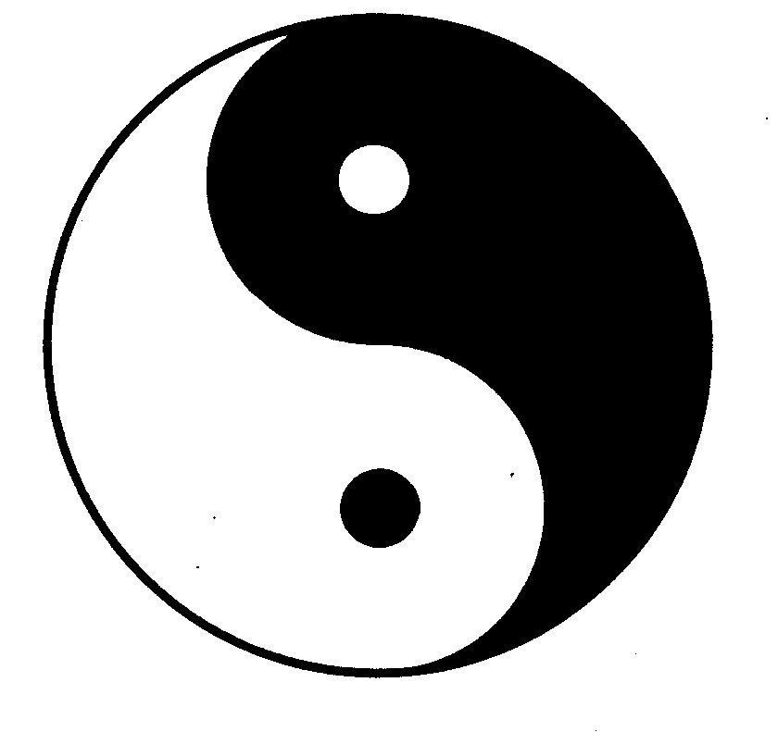
Daoism/Taoism
道教
Look to the past…(but differently)
Yearn for “an age of perfect virtue” where humans are in harmony with nature
Confucianism has ruined this
Even thought Daoism seems to contradict Confucianism → its viewed as complementary to Confucianism
Yin and yang
principle of nature & complementary forces, patterns and things that depend on one another and do not make sense on their own.
Notes:
Confucius on the street -→ government by goodness
Daoist at home → pursuing the simple life, reading, meditating enjoying landscape nature

Slide 6
YIN-YANG
Yin-Yang:
Represented in the Symbol of the Great Ultimate
In a sense they are opposites yet together, like the Dao
At the same time they keep the balance
Demonstrate the need for some sort of order that goes with the flow → essence of Daoism
All opposites represented within them:
Yin: black, female, dark, winter, cold, death, hate, etc.
Yang: white, male, light, summer, warm, life, love, etc.

Slide 7
Qi
Chi / Qi:
Literally self generating energy
Vital energy
Flows throughout body
Some daoists learn to control theirs and use it to their advantage = T’ai Chi (Taiji)

Slide 8
Qi (Chi)

Slide 9
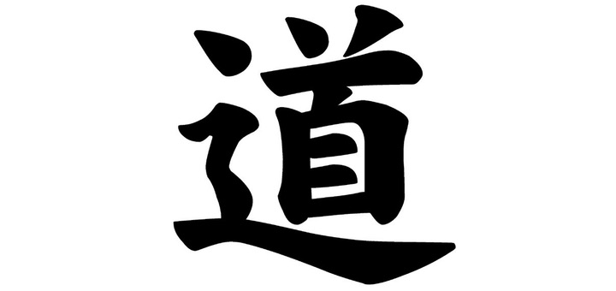
TAO TE CHING (Dao de jing)
Written by Lao Tzu
Series of short poems about life, philosophy, people, etc.
Divided into 2 parts:
Dao (the way) and
De (virtue)
(Jing = great book/classic)
Very relaxed mood and tone; language is very simple
Goal is to promote inner peace

Slide 10
WU-WEI
=non-action, inaction
The idea of wu-wei does not mean that people should sit around and do nothing, rather people should not indulge in useless efforts or actions or do anything that contradicts nature.
Just let things happen.
Notes:
Use an excerpt from The Lion King- Rafiki’s lesson about what is in the past is in the past.

Slide 11
Wu Wei
https://www.youtube.com/watch?v=NvZi7ZV-SWI

Slide 12
https://www.youtube.com/watch?v=ezmR9Attpyc

Slide 13
Annotate the Dao
With your partner…
Find Paradoxes
Find lines that represent the Taoist philosophy of Wu-Wei.
Find connections to nature or returning to nature.
Find clues to Qi
What do you think it means?

Slide 14
Lao Tzu’s Response to Confucianism
“The ideal ruler would stop meddling in the lives of people, give up warfare and luxurious living, and guide his people back to a state of innocence, simplicity, and harmony with the Tao, a state that existed in the most ancient times before civilization appeared to arouse the material desires of the people and spur them to strife and warfare, before morality was invented to befuddle their minds and beguile them with vain distinctions.”

