Slide 1
Literary Terminology
Literary Terminology may be on Act Quizzes, and will be on your Semester 2 Final Exam
Identify an example
Identify the definition
Analyze the effect

Slide 2
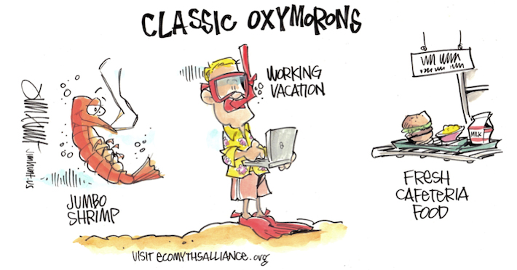
Literary Terminology
Oxymoron:
Apparently contradictory words appear in conjunction.
Pretty ugly
Alone together
Awfully good
Passive aggressive

Slide 3
Literary Terminology
Apostrophe:
When a person directly addresses someone or something not actually present: abstract concepts (love, etc.), people (dead or alive), place, or things (sun or sea).
“Twinkle, twinkle, little star, How I wonder what you are. Up above the world so high, Like a diamond in the sky.”
https://www.youtube.com/watch?time_continue=1&v=ynfu6hSqViI

Slide 4
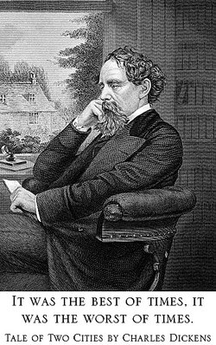
Literary Terminology
Antithesis:
Opposite/contrasting ideas presented parallel to one another.

Slide 5
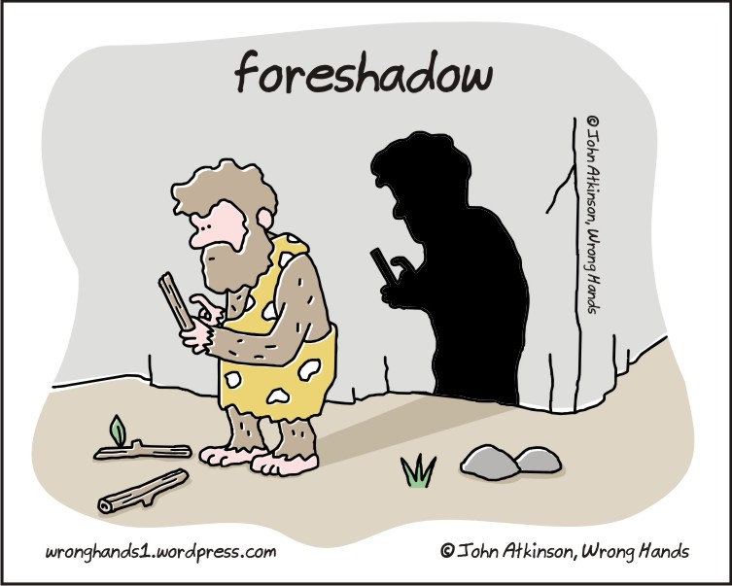
Literary Terminology
Foreshadow:
Phrases and hints that set the stage for the story to follow without revealing the ending or spoiling the suspense.

Slide 6
Literary Terminology
Subtext:
How a person conveys a sentence illustrates their actual meaning.
Tone
Inflection
Speed
Non verbals
Ambiguity:
Word, phrase or statement that contains more than one meaning: typically vague.
(white lie)

Slide 7
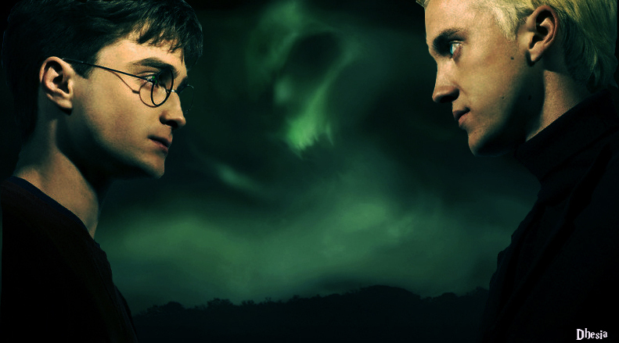
Literary Terminology
Character Foil:
A character that exhibits opposite or conflicting traits to another character.
Typically these opposites emphasize characterization

