Slide 1
ROMEO + JULIET Dramatic Terminology Part 1

Slide 2
Dramatic Terminology
Dramatic terminology may be on Act Quizzes, and will be on your Semester 2 Final Exam

Slide 3
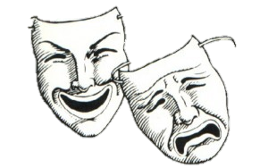
Dramatic Terminology
Comedy:
A play that has a happy ending, usually involving marriages between the unmarried characters, and a tone and style that is more light-hearted than Shakespeare's other plays.
Tragedy:
A play dealing with tragic events and having an unhappy ending, especially one concerning the downfall of the main character.

Slide 4
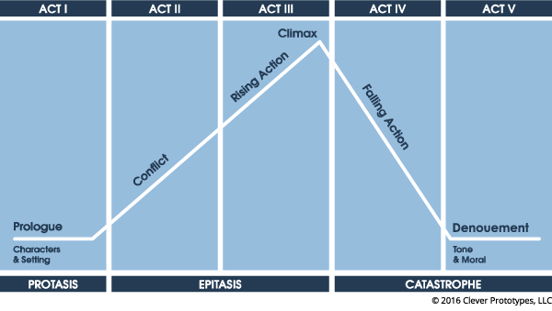
Dramatic Terminology
Act
A division within a play. Shakespeare’s plays are each 5 acts long.

Slide 5
Dramatic Terminology
Scene:
Each act is divided into scenes (could indicate changes in character, set, etc.)
Line:
Each scene is divided into lines. When referencing the text, you can reference the line number (some line numbers may differ depending on edition)

Slide 6
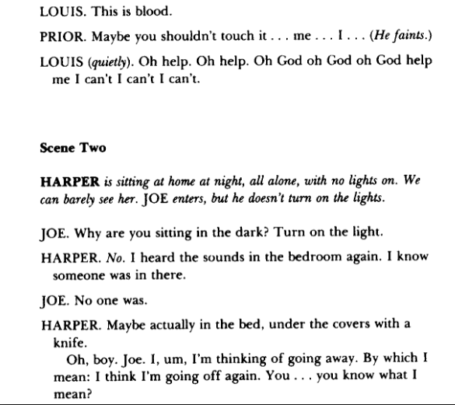
Dramatic Terminology
Stage Directions: Instructions in the text of the play, especially one indicating position, movement or tone of an actor, or sound effects and lighting.

Slide 7
Dramatic Terminology
Monologue
A long speech by one actor in a play or movie

Slide 8
Dramatic Terminology
Soliloquy:
The act of speaking one’s thoughts aloud when by oneself (or regardless of any hearers), especially by a character in a play.

Slide 9
Dramatic Terminology
Aside:
A remark or passage by a character that is intended to be heard by the audience (and possibly a select few characters) but unheard by the rest of the characters in the play.

Slide 10
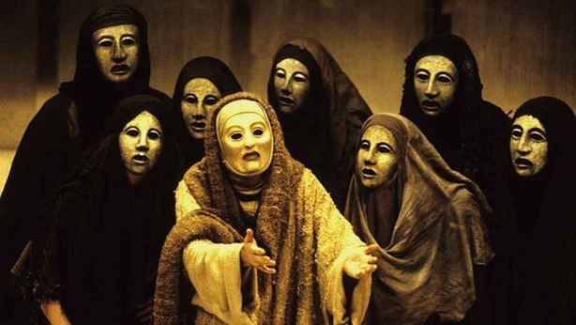
Dramatic Terminology
Chorus:
A character (or group of characters) that speaks the prologue and comments on the course of the events.
A chorus was a significant piece of Greek drama, arising from songs sung at various seasons to Dionysus; Athenian dramas used choruses to advise and restrain chief characters.

