Slide 1
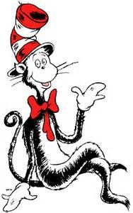
Allegory and Dr. Seuss
The more that you read,
The more things you will know,
The more that you learn,
The more places you’ll go.

Slide 2
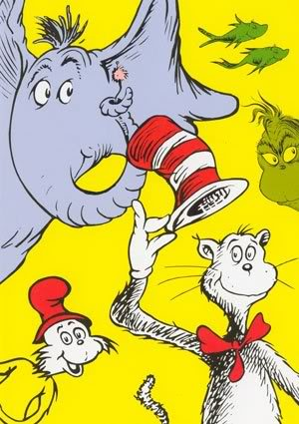
Prior knowledge: Dr. Seuss
How many of you have read Dr. Seuss books? Which ones do you remember? What are they about? What lessons can you learn from them?
Jot down as many as you can remember and write a possible theme statement for each one in your journals.

Slide 3
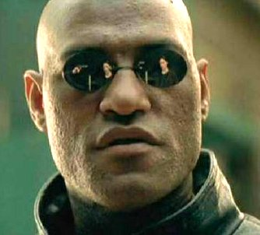
Dr. Seuss & Allegory
What if I told you that when you were a little kid reading Dr. Seuss, you were reading about racism and nuclear war?
Dr. Seuss is famous for his use of allegory in his children’s books, which makes them seem more like books made for adults.

Slide 4
Let’s focus in on….
Yertle the Turtle
The Butter Battle Book
The Sneetches
Horton Hears a Who
The Lorax

Slide 5
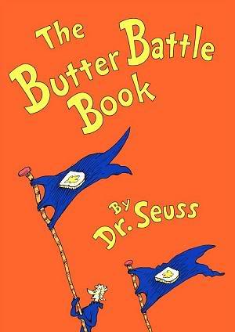
The Butter Battle Book is an allegory for the Cold War. Yooks & Zooks= USA and Russia buttering your bread a certain way= capitalism/democracy vs. Communism (different views of government) building bigger weapons= nuclear arms race

Slide 6
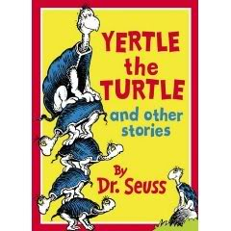
Yertle the Turtle is an allegory for Hitler and discrimination.

Slide 7
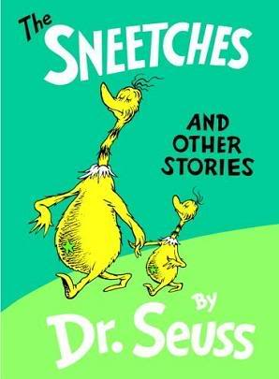
The Sneetches is an allegory for racism. Civil Rights Movement and/or Nazis vs. Jews It provides the message that race and ethnicity need not be dividing lines in our society, and that we can coexist peacefully, regardless of our external differences.

Slide 8
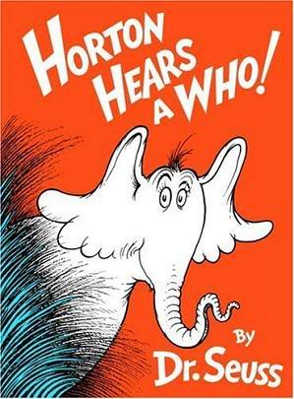
Horton Hears A Who is an allegory for the atomic bombing of Hiroshima and the U.S. Occupation in Japan. Dr. Seuss wrote this book as an apology for his extremely racist, anti- Japanese propaganda (political cartoons) that he created during WWII.

Slide 9
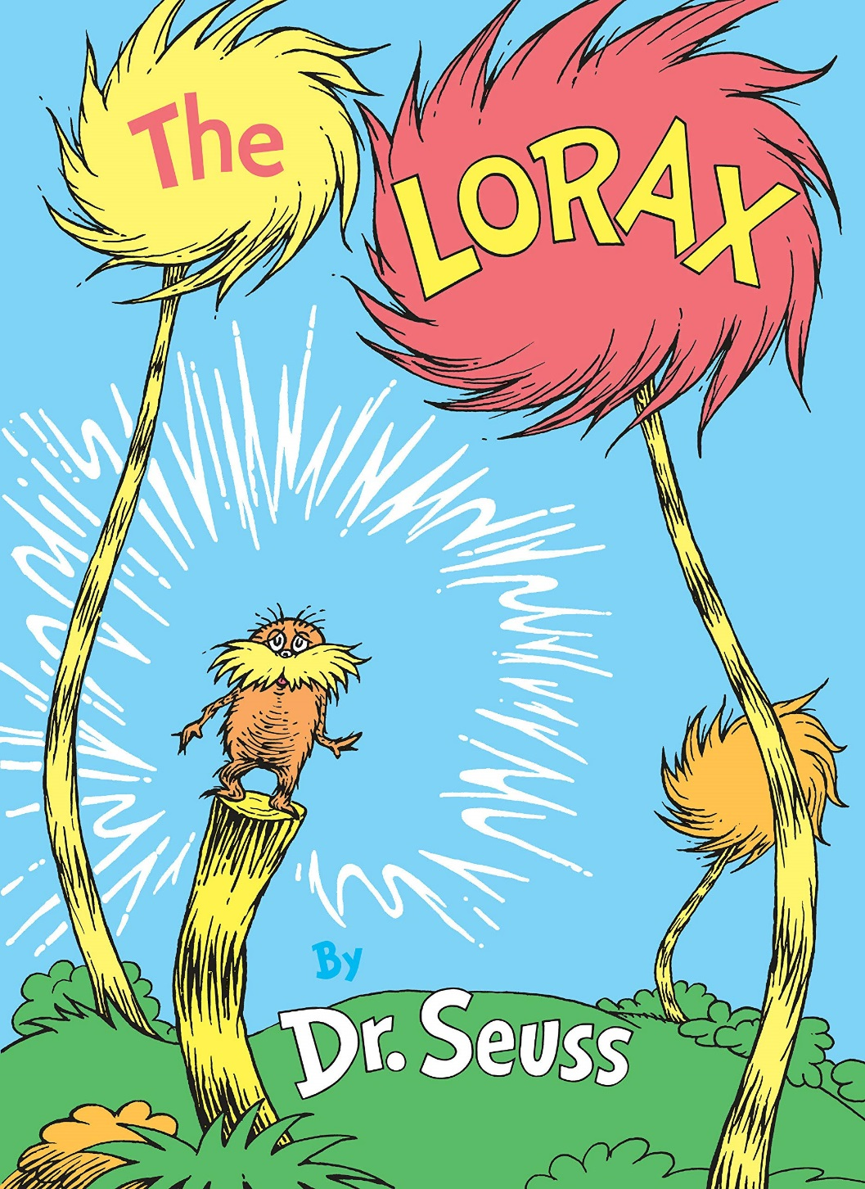
The Lorax is an allegory for the effects of industrialization and deforestation on the natural environment.

Slide 10
Defining allegory
Based on these examples, come up with a definition of allegory with your table group and write it on an index card.
On the front (lined side),write the definition
On the back, write the names/numbers of your groupmates
Deliver it to Ms. Gilpin at the front
You have 180 seconds!

Slide 11
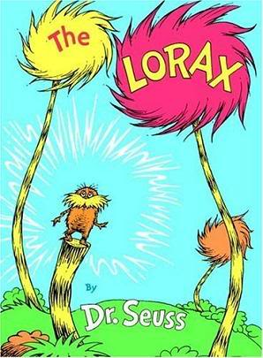
Allegory
a text that can be interpreted to reveal a hidden meaning, typically a moral or political one.

