Slide 1
characterization

Slide 2
Defining Characterization
Characterization is the process by which the writer reveals the personality of a character.
  direct characterization
  indirect characterization.

Slide 3
Direct Characterization
Direct Characterization tells the audience what the personality of the character is.
  Example: “The patient boy and quiet girl were both well mannered and did not disobey their mother.”
  Explanation: The narrator is directly telling the audience the personality of these two children. The boy is “patient” and the girl is “quiet.”

Slide 4
Indirect Characterization
Indirect Characterization shows things that reveal the personality of a character. There are five different methods of indirect characterization:

Slide 5
Indirect Characterization
Indirect Characterization
SPEECH: What does the character say? How does the character speak?
THOUGHTS: What is revealed through the character’s private thoughts and feelings?
EFFECT: What is revealed through the character’s effect on other people? How do other characters feel or behave in reaction to the character?
ACTIONS: What does the character do? How does the character act?
LOOKS: What does the character look like? How does the character dress?
S
T
E
A
L

Slide 6
“Evil Ms. Gilpin”
Two scenes to compare
The first uses direct characterization
The second uses indirect characterization

Slide 7
Use it in a sentence
EXAMPLES that use characterize as a verb:
Aladdin’s willingness to help a child in need characterizes him as generous.
Mickey Mouse’s cheerful smile and bouncy walk characterize him as optimistic and joyous.
When the adventurers return, everyone at the Bureau shows signs of relief and asks them if they are okay. This characterizes the adventurers as valuable to their friends.

Slide 8
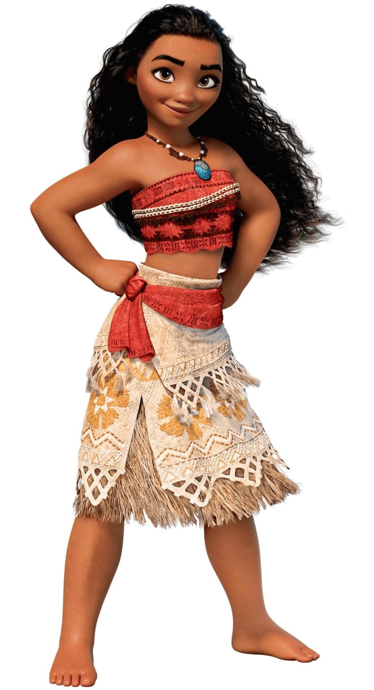
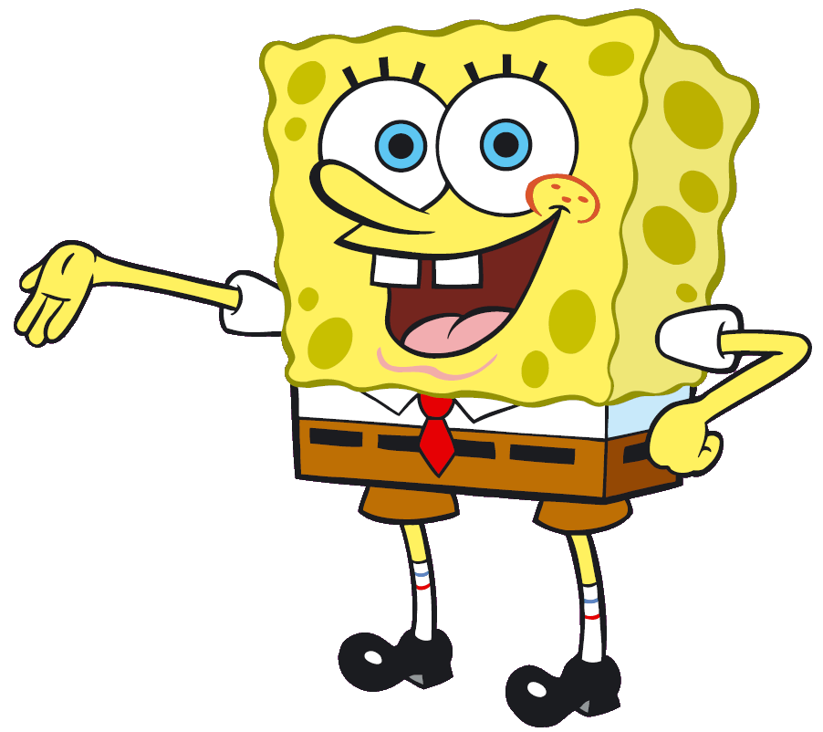
CHOOSE YOUR FIGHTER
How are these characters indirectly characterized?

