Slide 1
Figurative language
G9-19-20 Gilpin LA

Slide 2
Literary Devices/Techniques
Example: Symbol
Example: Figurative Language
Figurative language is language that is not literal, used for effect.
Sometimes called “figures of speech”
Not all lit devices are figurative language.

Slide 3
Figurative Language Devices in HOMS
Learning Targets:
Students will be able to define figurative language.
Students will be able to identify simile, metaphor, personification, idiom, hyperbole, and euphemism and explain their effect on the text.
Students will be able to give examples of simile, metaphor, personification, idiom, hyperbole, and euphemism

Slide 4
Examples of Figurative Language
Metaphor - figurative language that compares two (usually unrelated) things
Simile - figurative language that compares two (usually unrelated) things using like or as

Slide 5
Examples of Figurative Language
Personification - figurative language that gives human characteristics to inhuman things

Slide 6
Personification
She danced like the wind.
The wind danced around my face.

Slide 7
Examples in The House on Mango Street
Cats asleep like little donuts (13).
Our laughter for example. Not the shy ice cream bells giggle of Rachel and Lucy’s family, but all of a sudden and surprised like a pile of dishes breaking (17).
It’s like all of a sudden he let go a million moths all over the dusty furniture and swan-neck shadows and in our bones (20).
The nose of that yellow Cadillac was pleated like an alligator’s… (25).

Slide 8
Examples in The House on Mango Street
Lucy, Rachel, me, tee-tottering like so. Down to the corner where the men can’t take their eyes off us. We must be Christmas (40).
My feet swell big and heavy like plungers… (47).
…hips are scientific…They bloom like roses (50).
Esta muerto, and then as if he just heard the news himself, crumples like a coat and cries, my brave Papa cries (56).

Slide 9
Examples in The House on Mango Street
But I think diseases have no eyes. They pick with a dizzy finger anyone, just anyone. Like my aunt… (59)
They don’t walk like ordinary dogs, but leap and somersault like an apostrophe and comma (71).
They send ferocious roots beneath the ground. They grow up and they grow down and grab the earth between their hairy toes and bite the sky with violent teeth and never quit their anger (74).

Slide 10
Examples in The House on Mango Street
Huge, enormous, beautiful to look at, from the salmon-pink feather on the tip of her hat down to the little rosebuds of her toes (77).
The boys at school think she’s beautiful because her hair is shiny black like raven feathers and when she laughs, she flicks her hair back like a satin shawl over her shoulders… (81).
When you leave you must remember to come back for the others. A circle, understand? You will always be…Mango Street (105).

Slide 11
hyperbole
hyperbole - exaggerated statements or claims not meant to be taken literally
I ate a ton of food on Sunday.
The science teacher gave a billion hours of homework last week.
I’m literally dead.

Slide 12
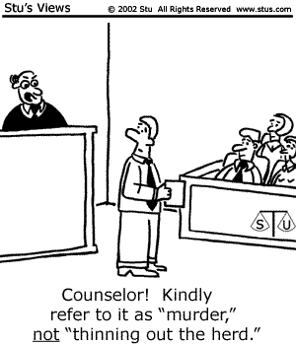
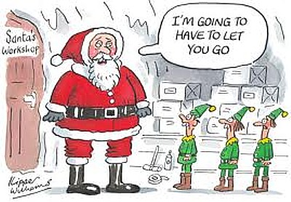
What does Euphemism mean?

Slide 13
What does Euphemism mean?
EXAMPLES:
Eric’s driving skills left plenty of room for improvement.
I got in a bit of trouble for stretching the truth about the broken lamp.
Ew! My dad wanted to have the birds and bees talk.
These TVs fell off the back of a truck.
Your grandma’s in a better place now.
He is just big boned.
Actually, I’m between jobs at the moment.
What are these people really saying?

Slide 14
Euphemism
euphemism: Mild or indirect word or expression that is figuratively used to replace something that is embarrassing or rude to talk about.
Euphemisms often are used to replace topics like:
Death
Your grandma’s in a better place now.
Sex
Ew! My dad wanted to have the birds and bees talk.
Other uncomfortable subjects

Slide 15
Euphemism in HOMS
“There was an Old Woman She Had So Many Children She Didn’t Know What to Do”
What was the Euphemism? What was the Euphemism for?

Slide 16
Euphemism in HOMS
We just read “There was an Old Woman She Had So Many Children She Didn’t Know What to Do”
What was the Euphemism? What was the Euphemism for?
Why would “hit the ground like a sugar donut” or “exploding star” not make a good euphemisms? (30).
With a partner come up with your own euphemism
Why would an author use euphemisms? How would it help create an unreliable narrator?
What evidence do we have that “learned to fly” is the euphemism?

Slide 17
What do these have in common?
To break one’s pipe – casser sa pipe - French
To pull the leathers – tirare le cuoia - Italian
To kick the calendar - kopnąć w kalendarz - Polish
To kick the bucket
They all mean “to die.”
What type of figurative language are these?

Slide 18
Idioms - Examples
On the ball
Bite the bullet
Get something out of your system
It’s raining cats and dogs
Kick the bucket
Get to the bottom of the situation
Cold shoulder
Couch potato

Slide 19
Idiom - definition
Idiom: a short phrase established by usage as having a fixed figurative meaning
Because idioms are figurative, you cannot translate them literally.
Most languages have their own idioms. Can you think of any in another language?

Slide 20
Let’s Review
What are the six types of figurative language that we covered?
Are those the only types of figurative language?
Figurative language is language that is not ___________.
True or false: a phrase can be more than one figurative language device at the same time.

