Slide 1
GRAPHIC TERMINOLOGY
Get ready to take some notes!

Slide 2
TURN & TALK
A: What’s a graphic novel?
B: What comes to mind when you think of the term “graphic novel” or “comic”?
C: What’s the difference between a “graphic novel” and a “comic”?

Slide 3
THE GRAPHIC NOVEL
A graphic novel is a medium (art form); watercolor painting, haiku poetry, memoir, magical realism narrative, etc.—all these are various mediums an artist can choose
Graphic novels pair sequential visual art with minimal text to tell a story

Slide 4
THE “UNIVERSALITY” EFFECT
The “cartoon” face appeals to wider audiences; it could describe a character who’s young or old, male or female, etc.

Slide 5
PANELS
PANELS: each framed image
Panels offer the reader a specific perspective (P.O.V.) through which they view the subject

Slide 6
GUTTERS

Slide 7
GUTTERS
GUTTERS: the space between each panel
GUTTERS provide transitions; something happens in that gutter space, but the reader must “fill in” that information
GUTTER

Slide 8
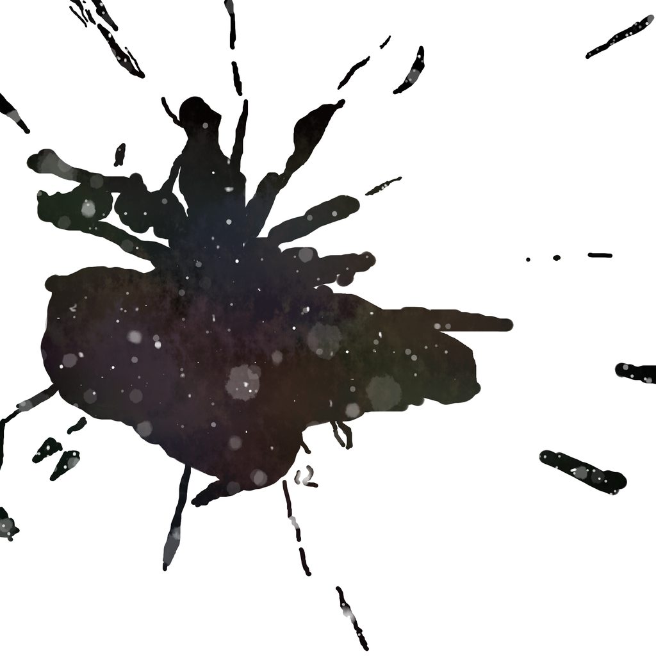
SPLASH & BLEED
SPLASH: A splash is a type of panel that spans the width of the page; a splash is used to grab the reader’s attention, and often establishes setting/time/place/mood…
BLEED: A panel that runs off the page—or seems to “bleed” beyond the edges of the paper—is called a BLEED.

Slide 9
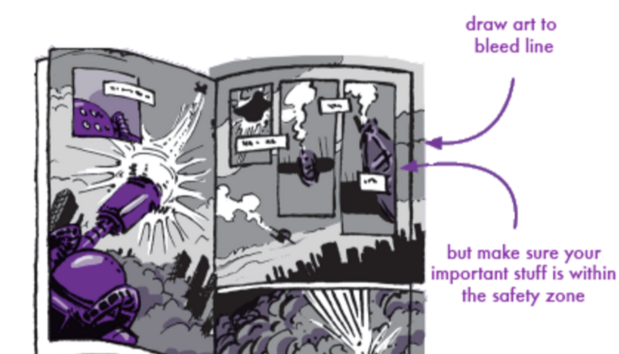

Slide 10
CAPTIONS, SPEECH BALLOONS, & EMANATA
CAPTIONS: (Boxed) words that give voice to the narrator.
SPEECH BALLOONS: Balloons extending from characters’ mouths which contain dialogue (aka, character speech); if the speech balloon is drawn using jagged lines, the character is shouting.
EMANATA: Artistic representations of feelings, emotions or movement, such as: tear drops sweat drops, exclamation marks, question marks, and/or motion lines.

Slide 11
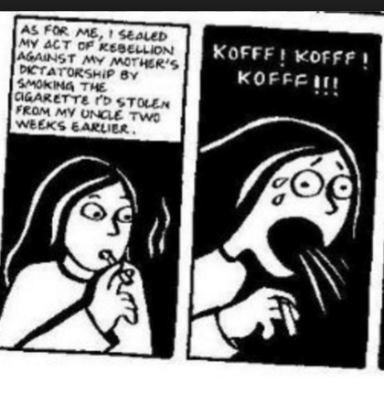
EMANATA & CAPTION (A COUPLE EXAMPLES…)
CAPTION

Slide 12
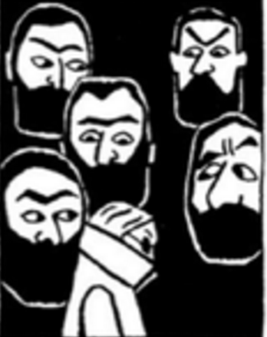
THOUGHT BALLOONS & GRAPHIC WEIGHT
THOUGHT BALLOONS: Clouds that contain a character’s thoughts.
GRAPHIC WEIGHT: The term used to discuss the amount of contrast in an image; are blacks offset with whites? Is vivid color used amidst muted colors? What stands out?

Slide 13
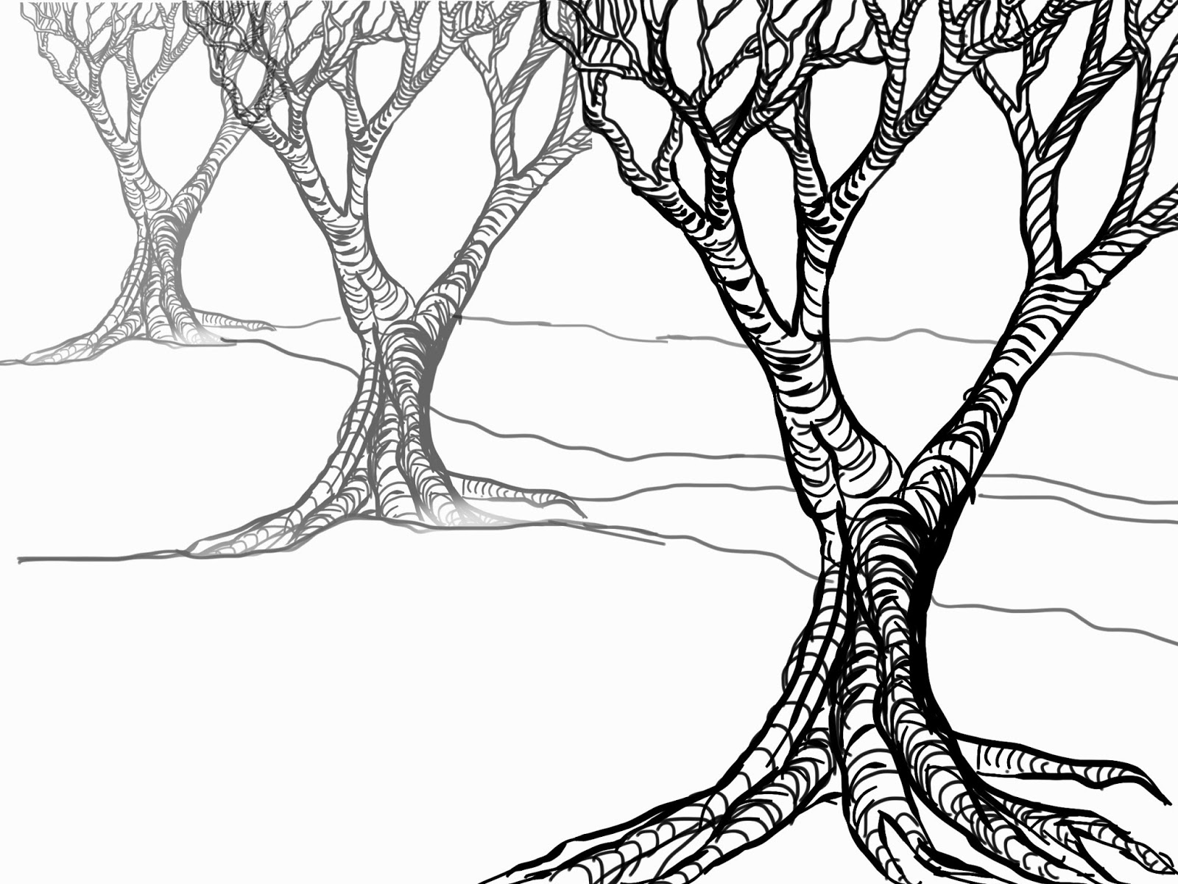
PANEL DEPTH
FOREGROUND: What’s depicted
closest to the reader; this is usually the subject.
MIDGROUND: Subjects depicted in the middle of the scene, in front of a background/setting
BACKGROUND: The objects that are furthest from the reader, usually conveying setting/ contextual details.

Slide 14
TRANSITIONS
TRANSITIONS occur within the “gutter” space between panels. Artists rely on the reader’s ability to create “closure” (aka, infer what happened during the gutter) to fill in missing information.
There are six types of transitions: 1) Moment to Moment, 2)Action to Action, 3) Subject to Subject, 4) Scene to Scene, 5) Aspect to Aspect, & 6) Non-sequitur

Slide 15
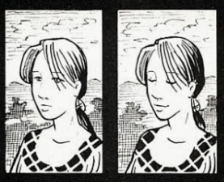
1) THE “MOMENT TO MOMENT” TRANSITION
MOMENT TO MOMENT transitions cover a few seconds in time; thus, they require very little from readers, and make the story’s pace seem rather slow. That said, each moment has an important feel, as it’s given its own panel.

Slide 16
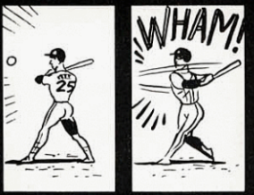
2) THE “ACTION TO ACTION” TRANSITION
ACTION TO ACTION transitions use the gutter to cover the bulk of a specific action. The first panel shows the start of an action, and the next panel shows the action being completed.

Slide 17
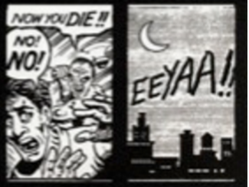
3) THE “SUBJECT TO SUBJECT” TRANSITION
SUBJECT TO SUBJECT: this transition shifts both time and subject; in this case, the viewer sees another ‘subject’ in the story, offering a different perspective

Slide 18
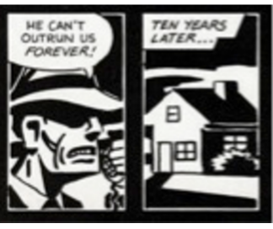
4) THE “SCENE TO SCENE” TRANSITION
SCENE TO SCENE: A jump in time and/or place. This type of transition forces the reader to fill in a lot of information, as shifts in time and/or place occurred in the gutter space.

Slide 19
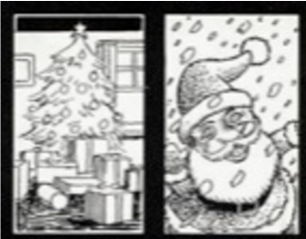
5) THE “ASPECT TO ASPECT” TRANSITION
ASPECT TO ASPECT: This transition provides a “wandering eye”, as time is frozen, and the panels provide various perspectives.

Slide 20
6) THE “NON-SEQUITUR” TRANSITION
NON-SEQUITUR: This transition jumps from one moment and subject, to something seemingly unrelated. The connection between the two panels might not become clear until much later in the story.

Slide 21
GRAPHIC TERMINOLOGY
MEDIUM
UNIVERSALITY EFFECT
PANEL
GUTTER
SPLASH
BLEED
CAPTIONS
SPEECH BALOONS
EMANATA
THOUGHT BALOONS
GRAPHIC WEIGHT
FOREGROUND
MIDGROUND
BACKGROUND
MOMENT TO MOMENT (TRANSITION)
ACTION TO ACTION (TRANSITION)
SUBJECT TO SUBJECT (TRANSITION)
SCENE TO SCENE (TRANSITION)
ASPECT TO ASPECT (TRANSITION)
NON-SEQUITUR (TRANSITION)

