Slide 1
Oral tradition – lecture notes
G9-19-20

Slide 2
Oral Tradition
Learning Targets:
Students will be able to define Oral Tradition.
Students will be able to define proverb, idiom, myth, and folktale.
Students will be able to explain what various proverbs mean in Things Fall Apart.

Slide 3
Oral Tradition
Oral Tradition is cultural material and tradition transmitted in spoken words from one generation to another.
This includes proverbs, idioms, myths, and folktales that have significance to the culture that they come from.
What do you think counts as cultural material?
Do civilizations that have written words still have an Oral Tradition?

Slide 4
Myths
a traditional or legendary story used to explain a cultural ritual or natural phenomenon passed down through oral tradition. Myths often feature a hero, god, or supernatural powers. Myths may have some scientific or factual basis– but they normally do not. Most myths are archetypal.
Why did early people want to explain the world they lived in?
What kind of natural phenomenon would early people have needed to explain?

Slide 5
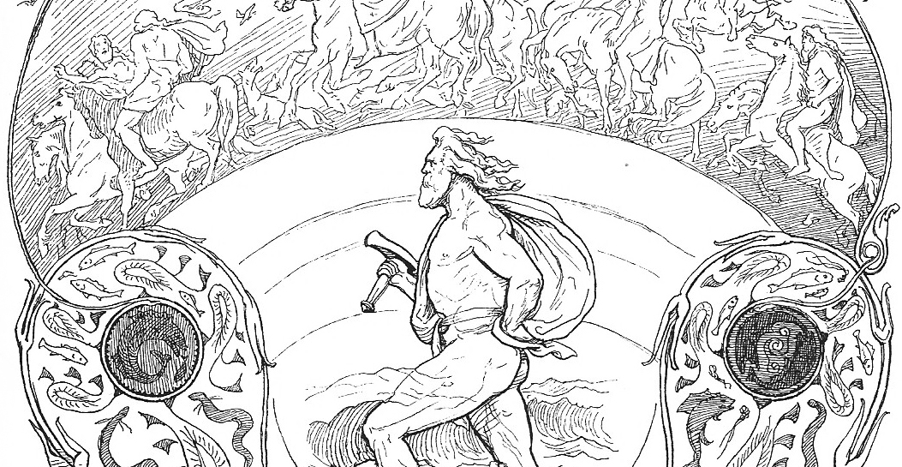
Myths: Examples
In Norse Mythology used Thor and his hammer Mjöllnir to explain the sound of thunder (Thor) and lightning (Mjöllnir).

Slide 6
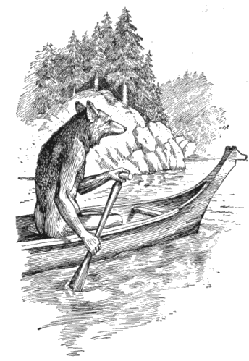
Myths: Examples
Coyote: in the mythology and folklore of the North American Plains, California, and Southwest Indians, the chief animal of the age before humans. Coyote’s exploits as a creator, lover, magician, glutton, and trickster are celebrated in a vast number of oral tales.
From Brittanica

Slide 7
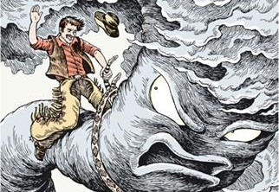
Folktales
a story without a known author that has been preserved through Oral Tradition, also archetypal.
Example: fairytales; American tall tales
Pecos Bill →

Slide 8
Proverbs
a short saying that describes a universal truth for the people who say it preserved through Oral Tradition.
Can you think of any examples of a proverb?
What kind of knowledge is a universal truth?

Slide 9
Proverbs: Examples
“The early bird catches the worm.”
“Two wrongs don’t make a right.”
“Those who don’t know history are doomed to repeat it.”
“People who live in glass houses shouldn’t throw stones.”
What kind of knowledge is a universal truth is contained in these proverbs?

Slide 10
Idioms
a short phrase established by usage as having a static figurative meaning. To understand an idiom a person needs to know what it means because they do not literally make sense.

Slide 11
Idioms: Examples

Slide 12
Idioms: Examples

Slide 13
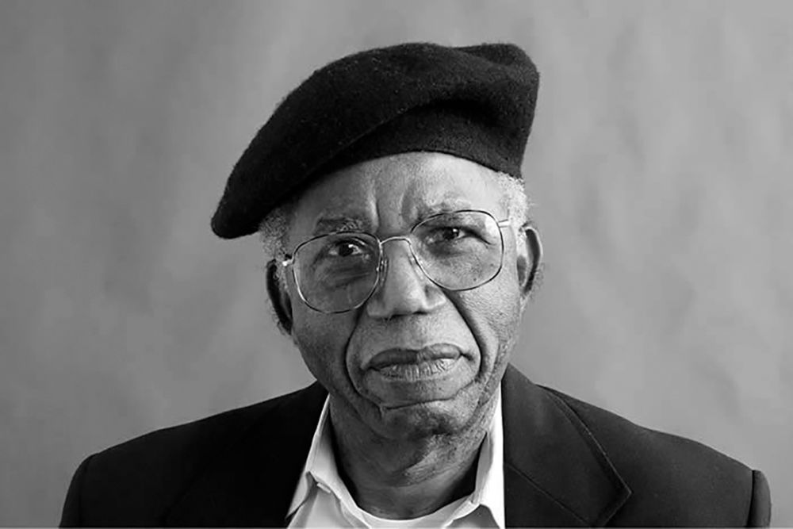
Things Fall Apart
Is a literary novel written by Nigerian author Chinua Achebe. The story's main purpose concerns pre- and post-colonial life in late nineteenth century Nigeria. It is one of the first African novels in English to receive global critical acclaim.
The novel follows the life of Okonkwo, an Igbo ("Ibo" in the novel) leader and local wrestling champion in the fictional Nigerian village of Umuofia. The novel contains a lot of traditional Igbo Oral Tradition.
More on Achebe tomorrow!

