Slide 1
Rhetoric: Connotation and Denotation

Slide 2
Rhetoric, Language, Propaganda
With your group rank each of the following lists of words from most positive to most negative:
List 1: Thin, slim, lanky, skinny, gaunt, slender
List 2: Aggressive, assertive, domineering, dynamic, pushy, forceful
Line 3: Shrewd, egghead, bright, clever, brilliant, cunning, smart, intelligent, brainy

Slide 3
Thinking Questions:
Was ranking the words easy or hard? Did your table group agree quickly on the most positive words easily in each list?
What is the difference in the meanings of the most positive and most negative words?
What does it mean that our lists were generally the same (or very similar) all over the room??
Why do you think this is?

Slide 4
Diction
Diction: word choice that a writer or speaker uses
Denotation: the literal (explicit) meaning of a word
Connotation: the implicit ideas and emotions we associate with a word or phrase. These meanings are socially constructed. Connotative meanings are dynamic over time.

Slide 5
Example…
Negative: There are over 2,000 vagrants in the city.
Neutral: There are over 2,000 people with no fixed address in the city.
Positive: There are over 2,000 people experiencing homelessness in the city.
The denotations of each word/phrase are very similar.
But the connotations are very different.
A vagrant is someone who is a public problem and underserving of help. A person experiencing homelessness is someone who deserves our empathy and help.

Slide 6
13.4
Connotation and Denotation
Write an example sentence that illustrates a the denotative similarities between “cheap” and “inexpensive” but also the connotative difference between the two.

Slide 7
Which words are negatively-connotated? Which words are positively-connotated?

Slide 8
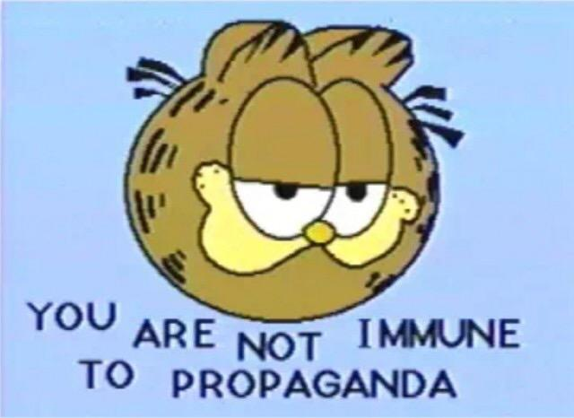
Rhetoric: Propaganda techniques

Slide 9
Propaganda
propaganda: The conscious effort to shape public opinion toward a certain ideological position
Not always bad!

Slide 10
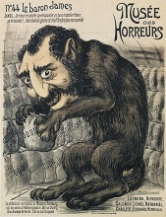
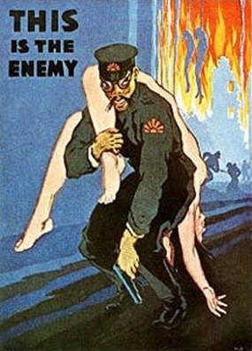
Name calling/ pinpointing the enemy
The use of derogatory images or words that carry a negative connotation when describing an enemy or opponent.

Slide 11
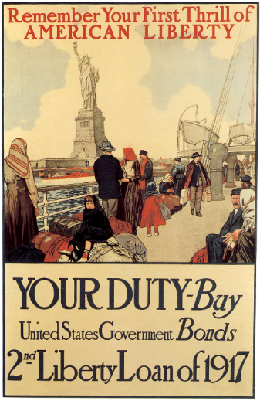
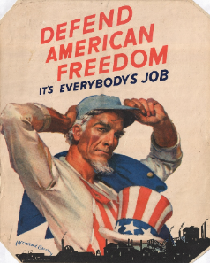
Glittering generalities
Using specific, positive language or phrases that people can not possibly argue against, such as “freedom” or “Liberty” or “Justice” etc. to persuade the audience to believe a specific idea.

Slide 12
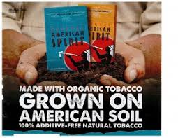
Card Stacking
Seeks to manipulate audience perception of an issue by emphasizing one side and repressing or omitting another, only presenting ideas in favor of one side.
Cherry picking facts that support your side to give an unfair advantage to one POV.

Slide 13
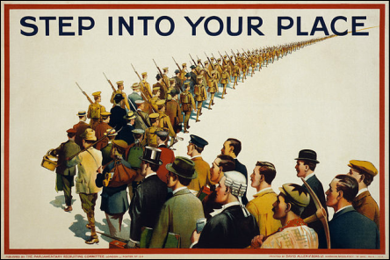
Bandwagon
The idea that you should do something because everyone else is doing it.
Don’t be the outsider- conform and belong!

Slide 14
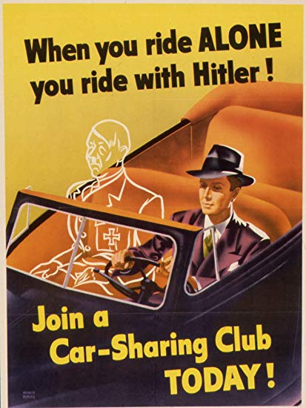
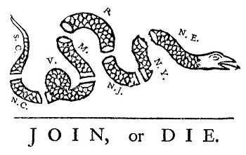
False Dilemma
A propaganda technique in which something is falsely claimed to be an "either/or" situation, when in fact there is at least one additional option.

Slide 15
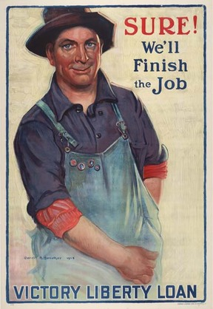
Plain Folks
The speaker presents him or herself as an average Joe — a common person who can understand and empathize with a listener's concerns. “I’m just like you!”
AND/OR:
Using everyday people to convince others to believe your point of view.

Slide 16
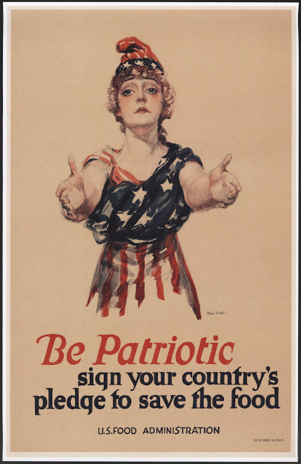
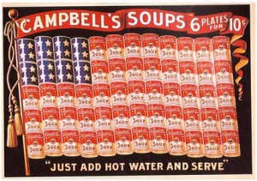
association
Associating a certain idea, person, or product with particular values, beliefs, etc.
Can be positive or negative to create the desired effect on target audience

Slide 17
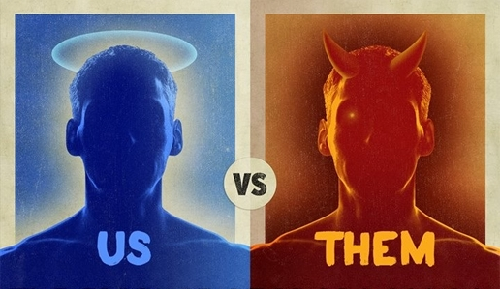
Simplification
Distortions of truth that overly simplify a complicated situation.
This can result in the formation of stereotypical images which are often distortions of the truth and which can lead to opinions based on prejudice. Ex: Throwing around the term “terrorist” loosely.

Slide 18
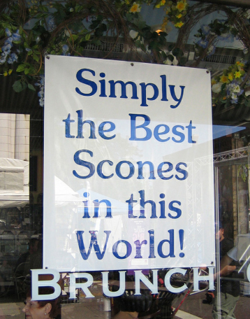
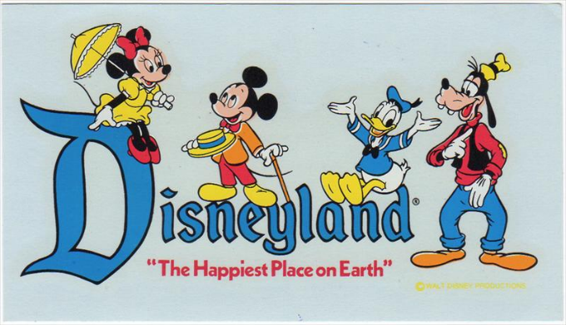
Assertion
Making a statement as fact that is impossible to be measured.
Ex. “Yakima is the greatest city in the world!”

Slide 19
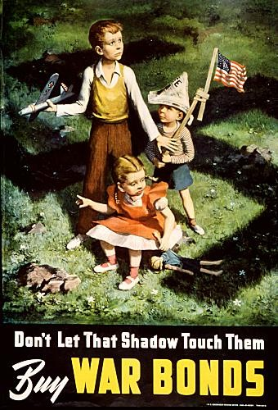
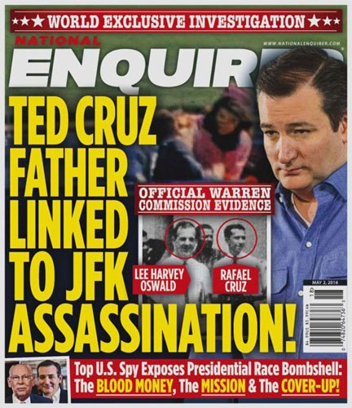
Emotive language or images
The use of powerful words, phrases, or images that evoke specific emotions within the target audience to persuade them through emotion as opposed to logic.
“Trigger words”
Use of children
Attention grabbing headlines
Linked to pathos

Slide 20
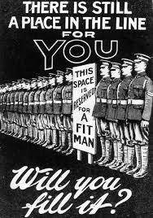
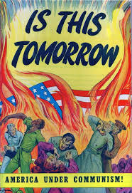
Questioning
Asking the target audience a specific question to persuade them
Call to action
Appeals to fear, patriotic feelings, or other strong emotions

