Slide 1
Rhetoric – Ethos, logos, pathos
G9-19-20

Slide 2
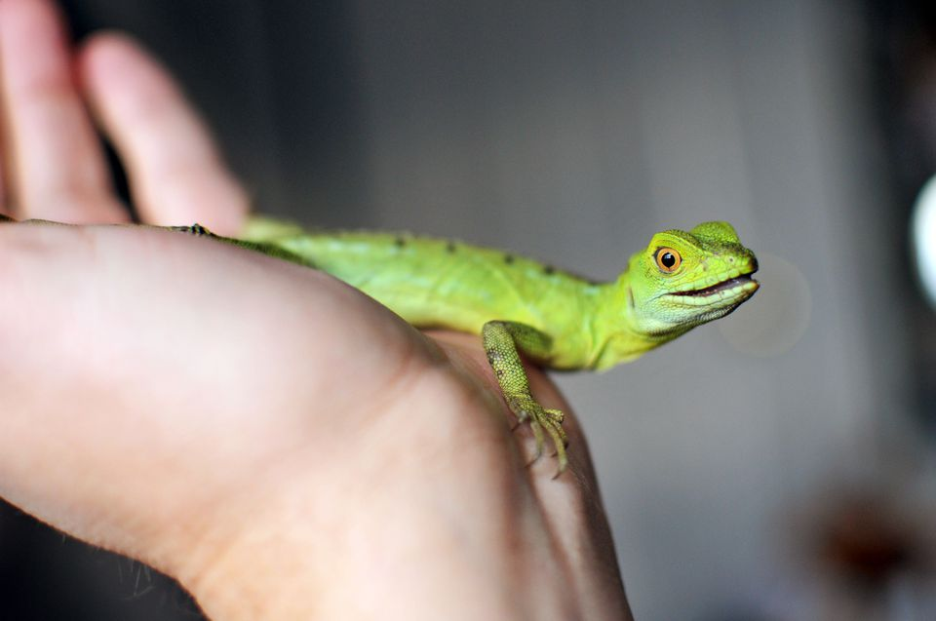
rhetoric
rhetoric: the art of effective or persuasive speaking or writing

Slide 3
RHETORIC in everyday TEXT…
Political discourse
Speeches
Advertising
Social Network
Editorials (opinion articles)
Essays

Slide 4
APPLYING RHETORIC…
Resume
Social Media
E-mail
Persuasive Essay
Speech

Slide 5
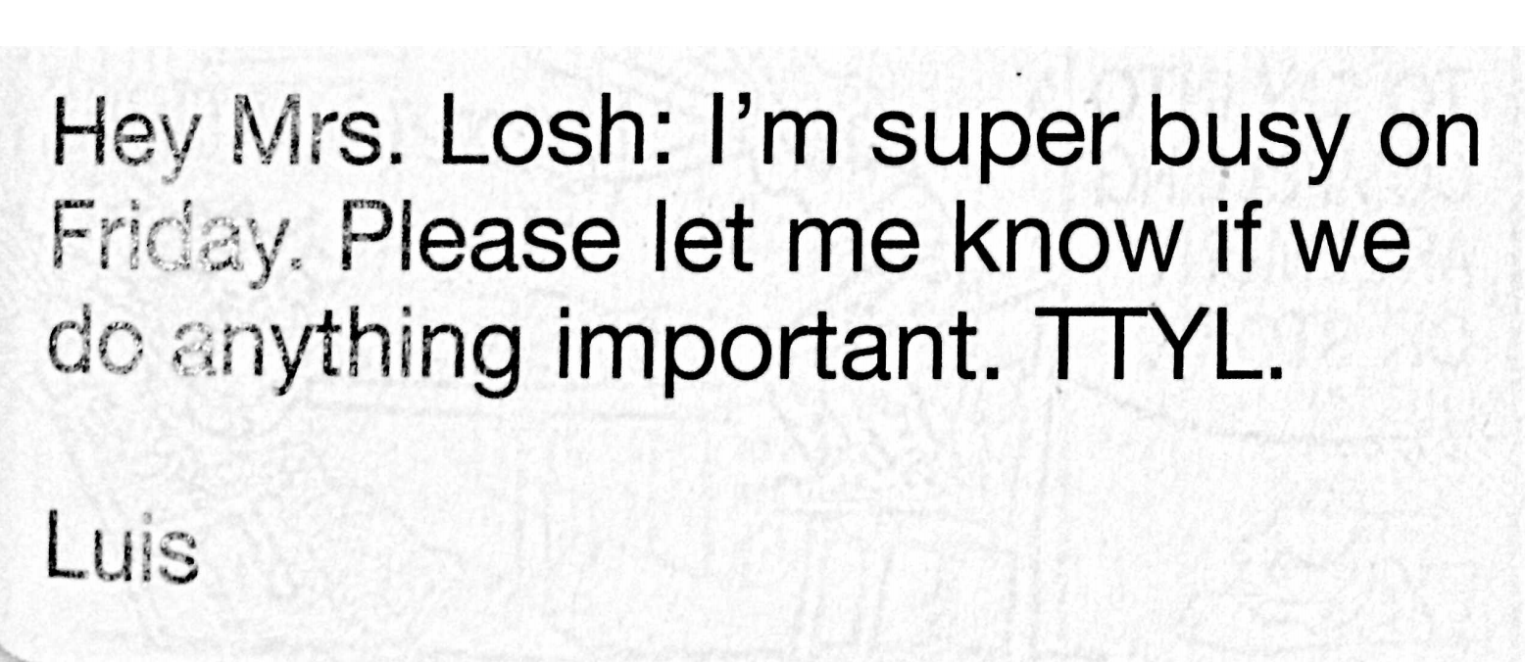
An example ☹

Slide 6
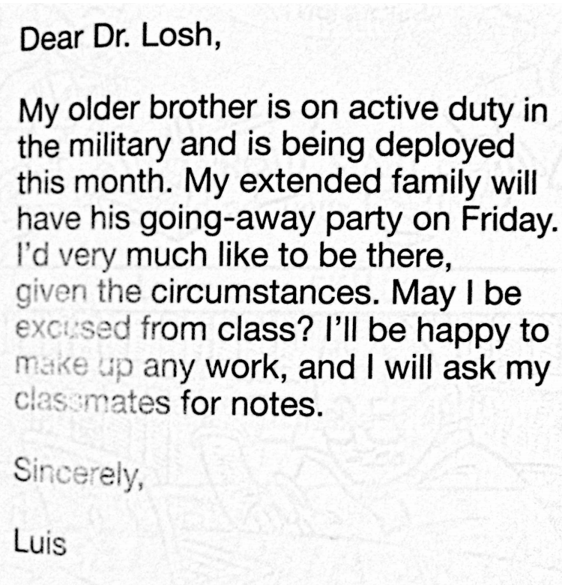
A (revised) example ☺

Slide 7
So, what?
The media/corporations/politicians/everyone else is constantly trying to persuade you.
The words, images, and sounds they choose work together to make you believe what they want you to believe.
We’ll learn to analyze the rhetorical devices and propaganda to determine the motivation and message of the information we take in.
Always question everything you see, hear, and read.
Always ask yourself: Who benefits from the information you’re seeing?

Slide 8
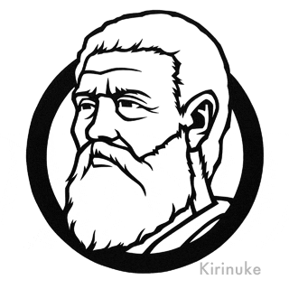
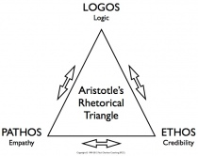
Greek Foundations of rhetoric
PLATO
Greek philosopher – Aristotle’s teacher
Believed rhetoric was manipulative & divisive
ARISTOTLE
(Unlike his teacher, Plato believed rhetoric brought people together)
Believed effective arguments included a mix of: ethos, logos, & pathos
ETHOS
LOGOS
PATHOS

Slide 9
“Other Men’s Flowers”
Critically read the 1st page of the article with your table.
How does the author define rhetoric?
What is the best advice for being persuasive?
Find the words ethos/logos/pathos. What do they mean?

Slide 10
Rhetoric
Learning Target:
Students will be able to define and identify and create ethos, logos, and pathos in media and texts.

Slide 11
Rhetorical Triangle
Aristotle taught that a speaker's ability to persuade is based on how well the speaker appeals to their audience in 3 different areas: ethos, pathos, and logos.
These areas form what is called the Rhetorical Triangle, with ALL EQUAL LENGTH SIDES…. Why?

Slide 12
Ethos
Ethos is the speaker’s ethical appeal, that is, how well the speaker presents him or herself.
Does the speaker seem:
knowledgeable and reasonable?
like an ‘expert’ or very experienced on the topic?
trustworthy?

Slide 13
Ethos
Kerri Walsh is a multiple Olympic Gold Medalist in Beach Volleyball.
If you eat Corn Flakes, you are like an Olympic Gold Medalist!
If she’s eating them, they must be good for you, because she is an Olympic Gold Medalist and they are healthy!

Slide 14
Logos
Logos is the argument's logical appeal, that is, how well the speaker uses the "text" of their own argument and evidence.
Effective arguments will probably include facts and other supporting details to back up the speaker’s claims.
They may contain testimony from authorities and will demonstrate the speaker’s carefulness in choosing and considering evidence.
“Common sense” counts, but generally isn’t considered a rhetorically strong logos appeal.

Slide 15
Logos
The Pepsi Challenge
Blind Taste-test
Why is this an example of logos?

Slide 16
Pathos
Pathos is the argument's emotional appeal, that is, how well the speaker taps into the audience’s emotions
Does the argument, language, and content appeal to your emotions:
Sadness
Pride
Fear
Anger
Patriotism
Love
Justice
Negative emotions are often more motivating than positive ones.

Slide 17
Pathos
What is this ad saying about secondhand smoke?
How do they convince you of their argument?
How do you feel when you see this child?

Slide 18
Ethos, Logos, and Pathos
Note: Ethos refers to the SPEAKER, though you can use the actual language, structure, content, arguments, evidence, etc. to build it.
However, Logos and Pathos refer to the actual language, structure, content, arguments, evidence, etc. used.

