Slide 1
Language analysis
Annotate your source by identifying 2-3 elements of rhetoric and persuasion for each source. Provide short explanations of significance for your annotations (go beyond just identification).
Can include...
Elements of the Rhetorical Triangle
Diction (Connotation/denotation)
Propaganda techniques (for cartoons)
Some other language technique

Slide 2
Ussr 1964
"THESE ARE CHAINS, AND THESE ARE CHAINS. DOES IT MATTER WHAT METAL THEY ARE MADE FROM?
This propaganda poster uses the propaganda technique of __________ to convince the audience that American economics (represented by a gold dollar sign) is just as controlling as slavery (represented by the chains).

Slide 3
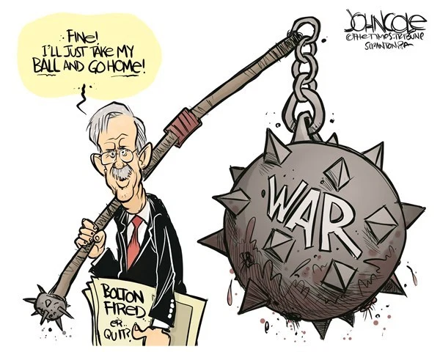
Strong analysis
Strong analysis connects a how to a what and so what -
HOW: What TECHNIQUE is being used?
Get VERY SPECIFIC. You cannot just say "the cartoon depicts people negatively." How do you see that it's negative?
WHAT: Do not stop at just identifying a propaganda technique.
"This shows the propaganda technique of assertion" - how do you KNOW? WHAT shows that technique?
SO WHAT: What is the MESSAGE that is being created by the HOW and WHAT?
Former National Security Advisor John Bolton is being depicted as war-hungry, holding a symbolic, exaggerated mace. He casually refers to it as "a ball," like a child quitting a game, but the viewer can see that the "ball" is very dangerous. This is a criticism of his war-focused views.

