Slide 1
Theme concepts and theme statements

Slide 2
Theme!
A theme is a message or main idea that the writer wants the reader to remember after reading his/her work.
Most stories, plays, novels, and poems have more than one theme.

Slide 3
Lesson objective
Differentiate between theme concepts and theme statements.
Identify theme concepts and theme statements in given texts.
Find evidence in texts that show how the author develops a theme.

Slide 4
What a “text” is really about is called its theme
We talk about theme in two ways:
Theme Concept: the topic the text is really about– sometimes this is hidden through figurative language - (noun or noun phrase)
*Themes address universal human concepts*

Slide 5
For the chart below, as a table, decide if each word or idea is likely to be a theme concept, or not.
1. Truth | 2. Family | 3. Revenge
4. Fear of failure | 5. Hair | 6. Cooking
7. Suitcase | 8. Trust | 9. Football
10. Power of words | 11. Love | 12. Good vs. Evil

Slide 6
For the chart below, as a table, decide if each word or idea is likely to be a theme concept, or not.
1. Truth | 2. Family | 3. Revenge
4. Fear of failure | 5. Hair | 6. Cooking
7. Suitcase | 8. Trust | 9. Football
10. Power of words | 11. Love | 12. Good vs. evil

Slide 7
What a “text” is really about is called its theme
We talk about theme in two ways:
Theme Concept: the topic the text is really about– sometimes this is hidden through figurative language - (noun or noun phrase)
Theme Statement: the author’s specific message about that topic; this is created by how the author writes about the subject - (sentence)
*Themes address universal human concepts*

Slide 8
theme
Theme Concept | Theme Statement
love
revenge
good vs. evil
beauty

Slide 9
theme
Theme Concept | Theme Statement
love | Love is blind.
revenge
good vs. evil
beauty

Slide 10
theme
Theme Concept | Theme Statement
love | Love is blind.
revenge | Revenge is a dish best served cold.
good vs. evil
beauty

Slide 11
theme
Theme Concept | Theme Statement
love | Love is blind.
revenge | Revenge is a dish best served cold.
good vs. evil | Good always conquers evil.
beauty

Slide 12
theme
Theme Concept | Theme Statement
love | Love is blind.
revenge | Revenge is a dish best served cold.
good vs. evil | Good always conquers evil.
beauty | Beauty is only skin deep.

Slide 13
theme
NOTE: Not every theme concept creates the same theme statement!
The theme statement is often the author’s message about the theme concept.
Theme Concept | Theme Statement
good vs. evil | Good always conquers evil.
good vs. evil | Doing good is a waste of time; help yourself.

Slide 14
theme
NOTE: Not every theme concept creates the same theme statement!
The theme statement is often the author’s message about the theme concept.
Theme Concept | Theme Statement
revenge | Revenge is a dish best served cold.
revenge | Revenge will never heal you; only forgiveness can

Slide 15
Disney Themes

Slide 16
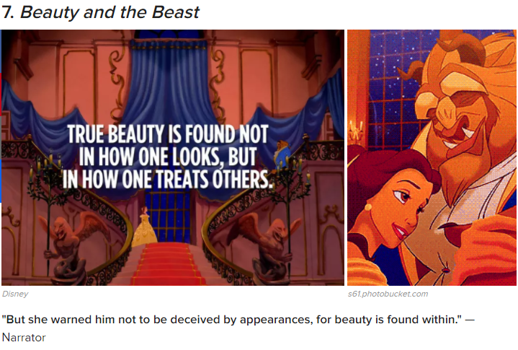

Slide 17
Concept, statement, or neither?
Love is a waste of time.
Good vs evil
Good will always triumph over evil.
Language is powerful because it both connects and divides people.
Honor and valor
Medieval art
Pride
Too much pride will lead to downfall.
Lamp

Slide 18
HOMS Outline prompt
How does Cisneros use a literary technique to develop a theme of House on Mango Street?
What is Cisneros’s message in HOMS, and how does she create that message using language?

Slide 19
What a “text” is really about is called its theme
Theme in a story is its underlying message, or 'big idea.' In other words, what critical belief about life is the author trying to convey in the writing of a novel, play, short story or poem?
This belief, or idea, transcends cultural barriers. It is usually universal in nature. When a theme is universal, it touches on the human experience, regardless of race or language. It is what the story means. Often, a piece of writing will have more than one theme.

